Slide 1
Architectural CAD I – IM230
Vocabulary

Slide 2
GROUP 5
Vocabulary

Slide 3
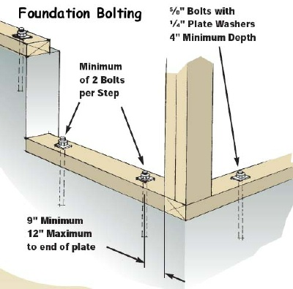
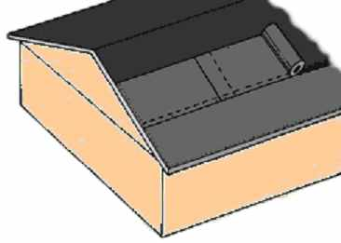
ANCHOR BOLT
A steel bolt usually fixed in a building structure with its threaded portion projecting; used to secure frameworks, timbers, machinery bases, etc
ASPHALT ROOFING PAPER
An asphalt coated paper that is applied to the roofing deck prior to the installation of roofing material

Slide 4
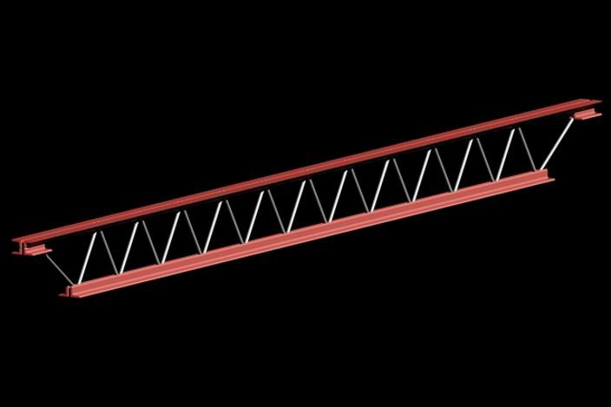
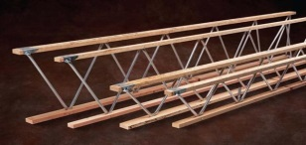
BAR JOIST
An open-web steel joist consisting of a single bar, bent in a zigzag pattern, and welded at its points to upper and lower chords
WEB JOIST
A truss where the members join at the top and bottom chords creating an open web area where mechanical, plumbing, and electrical lines can be run

Slide 5
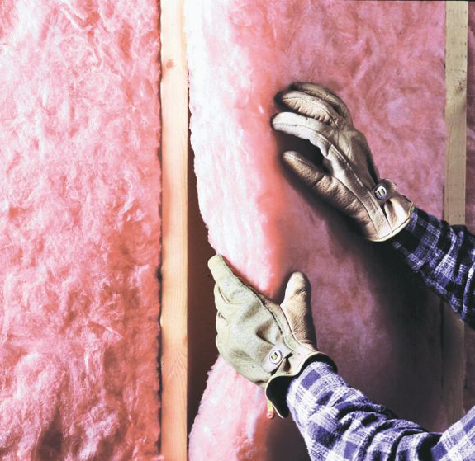
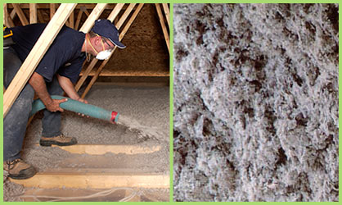
BATT INSULATION
A flexible blanket-type thermal insulation, commonly used as insulation between studs or joist in frame construction. Sometimes has a vapor barrier on one side or is entirely enclosed in paper
CELLULOSE INSULATION
A natural material, usually jute, flax, hemp, etc.; used for insulation purposes and is typically blown into the space

Slide 6
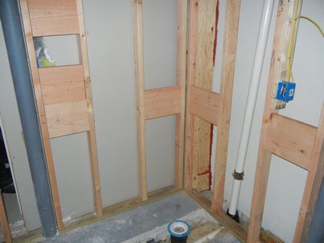
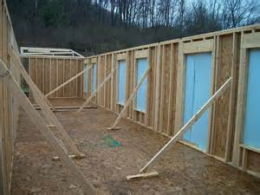
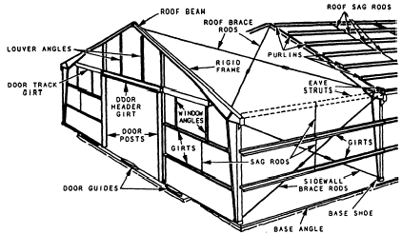
BLOCKING
Pieces of wood used to secure, join, or reinforce members, or to fill spaces between them
BRACING
Structural elements installed to provide restraint or support (or both) to other members, so that the complete assembly forms a stable structure

Slide 7
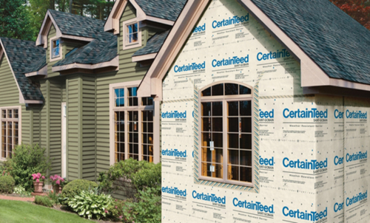
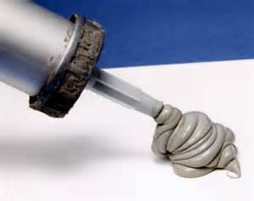
BUILDING PAPER
A durable paper, usually tyvek, installed over the building sheathing to provide weather protection and acts as a vapor barrier
CAULKING
A resilient mastic compound, often having a silicone or rubber base, used to seal cracks, fill joints, prevent leakage, and/or provide water or fire proofing

Slide 8
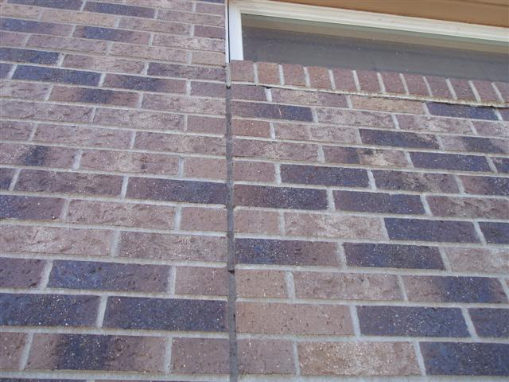
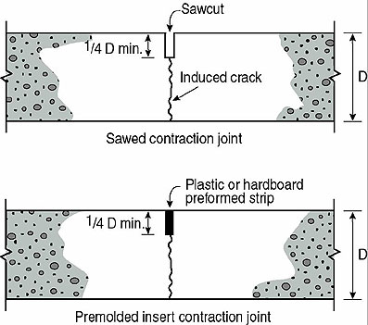
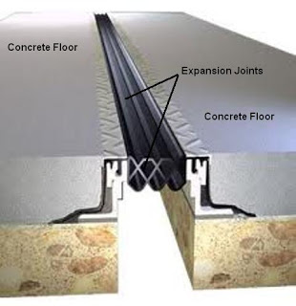
CONTROL JOINT
A groove which is formed, sawed, or tooled in a concrete or masonry structure to regulate the location and amount of cracking and separation resulting from dimensional change
EXPANSION JOINT
A joint or gap between adjacent parts of a building, structure, or concrete work which permits their relative movement due to temperature changes without rupture or damage

Slide 9
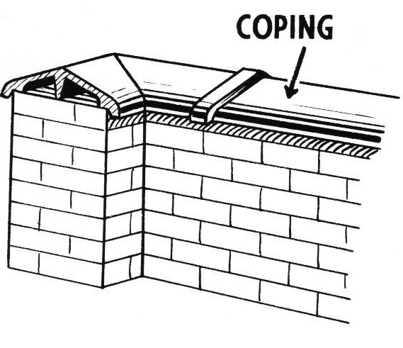
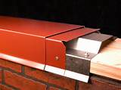
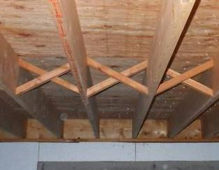
COPING
A protective cap or cover of a wall or parapet
CROSS BRACING/X-BRACING
Any system of bracing in which the diagonals intersect

Slide 10
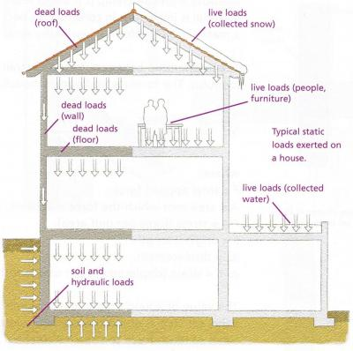
LOAD
A force, or system of forces, carried by a structure, or part of the structure
DEAD LOAD
The weight of a structure itself, including the weight of fixtures or equipment permanently attached to it

Slide 11
DYNAMIC LOAD
Any load which is nonstatic, such as a wind load or a moving live load
LIVE LOAD
The moving or movable external load on a structure; includes the weight of furnishings of a building, of the people, of the equipment, etc., but does not include wind load

Slide 12
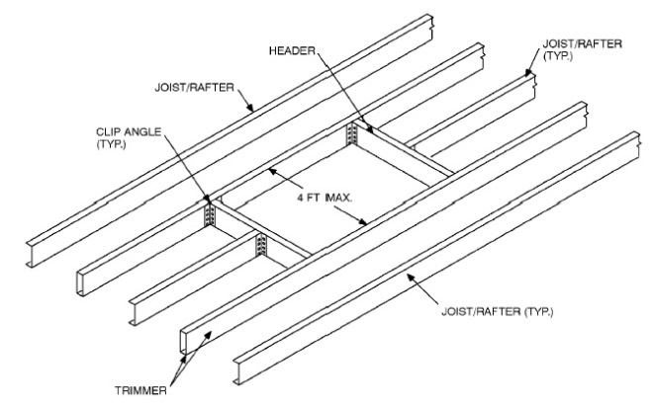
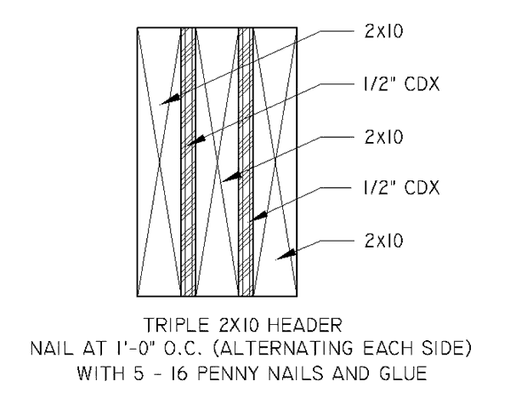
HEADER
A framing member which crosses and supports the ends of joists, rafters, etc. transferring the weight of the latter to parallel joists, rafters, etc
DOUBLE/TRIPLE HEADER
A header made of two pieces of lumber, fixed together by bolts or nails, to provide greater strength than a single piece. (Three pieces is a triple header)

Slide 13
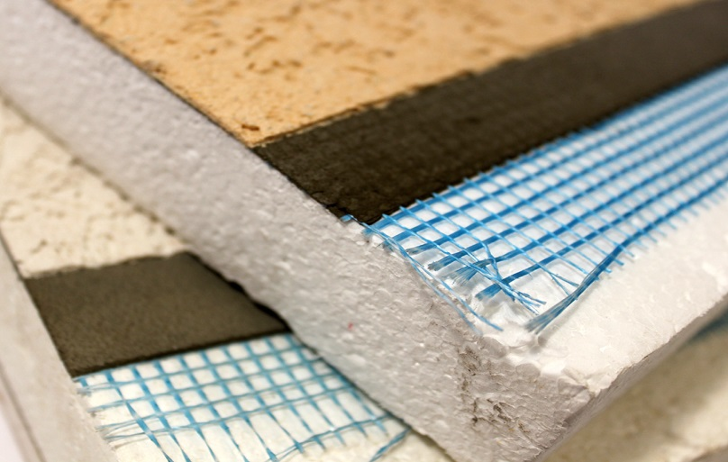
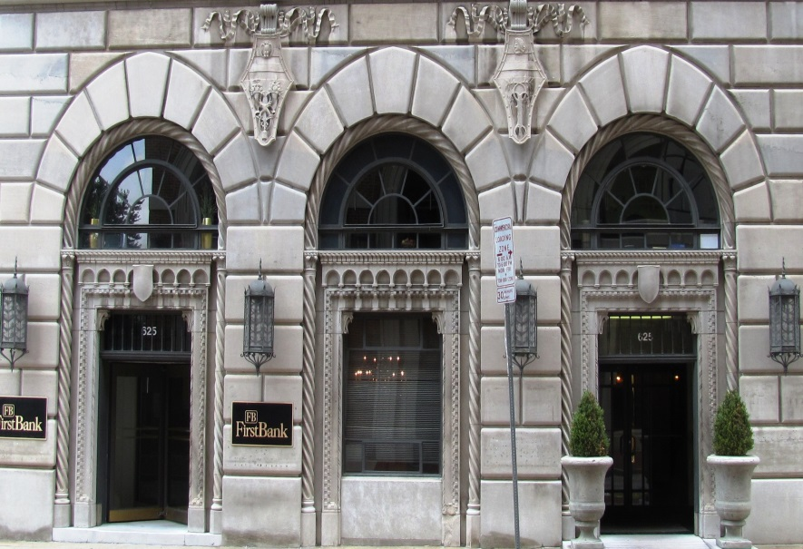
EIFS
Exterior Insulation Finishing System, an outer finishing system, usually of a foam base material, that provides protection against weather and provides additional thermal value
FAÇADE
The exterior face of a building

Slide 14
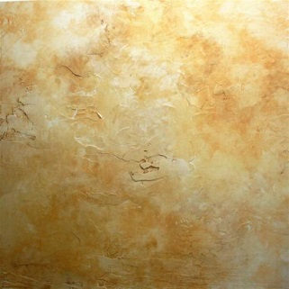
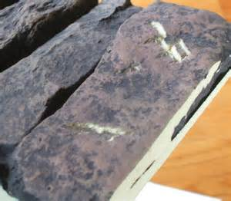
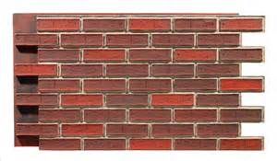
FAUX
A fake or imitation material made to resemble the original material. Examples: Painting techniques to give the appearance of marble, synthetic or manufactured brick and stone made to look like the real brick or stone, but weighs and cost less
GAUGE/GAGE
The thickness of sheet metal or metal studs

Slide 15
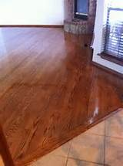
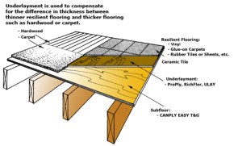
FINISH FLOOR
The floor, usually laid over a subfloor, which provides the complete floor surface
SUBFLOORING
A rough floor, laid on joists, which serves as a base for the finished floor

Slide 16
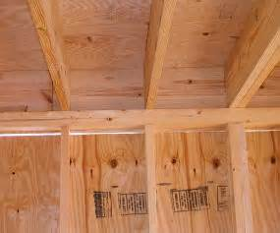
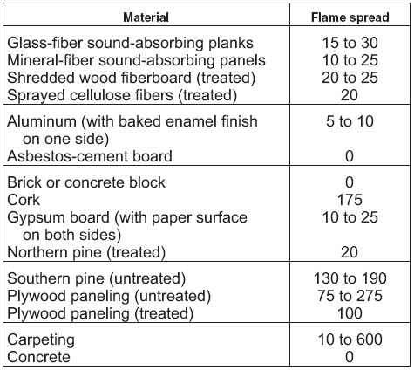
FIRE STOPPING
In a concealed, hollow construction, a material or member which fills or seals the open construction to prevent or retard the spread of fire
FLAME SPREAD RATING
A numerical designation, applied to building materials, which is a comparative measure of the ability of the material to resist flaming combustion over its surface

Slide 17
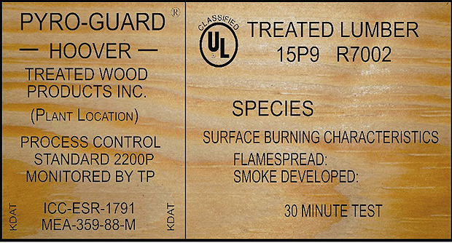
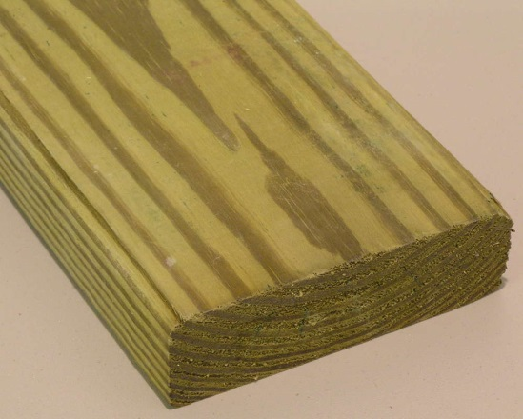
FIRE TREATED WOOD
Lumber or plywood which has been impregnated, under pressure, with minerals salts, that in the event of fire, the burning wood and salts emit noncombustible gases and water vapor instead of the usual flammable vapors
PRESSURE TREATED WOOD
Lumber or plywood which has been impregnated, under pressure, with chemicals that treat the wood against weather and rot

Slide 18
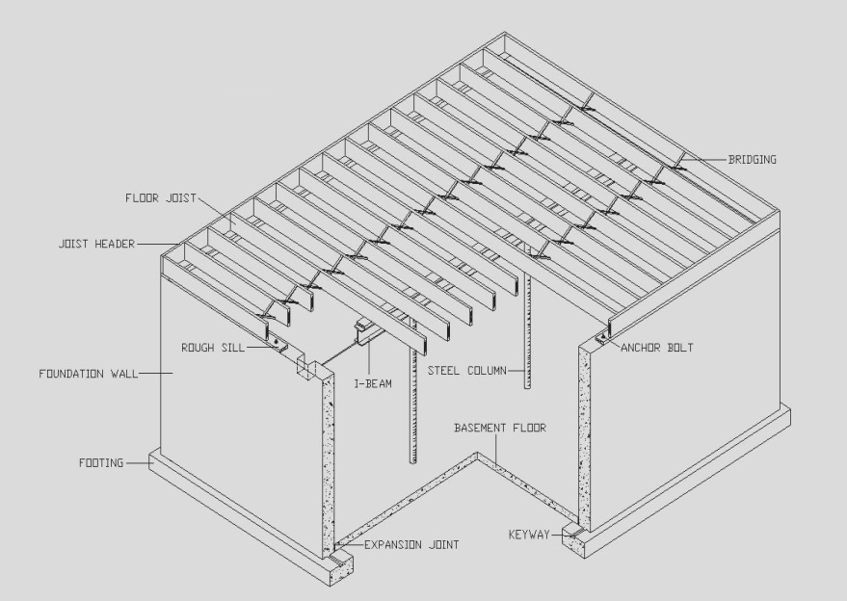
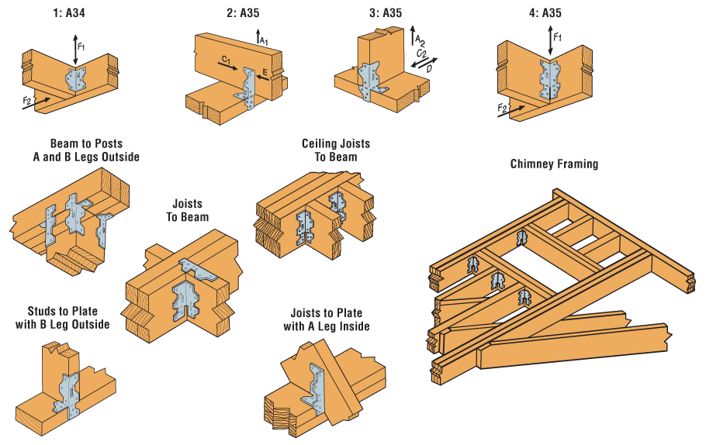
FLOOR FRAMING
Framing consisting of common floor joists, cross bridging, and other members which provide support for flooring
FRAMING ANCHOR
A metal device used in light wood-frame construction for joining studs, joists, rafters, etc

Slide 19
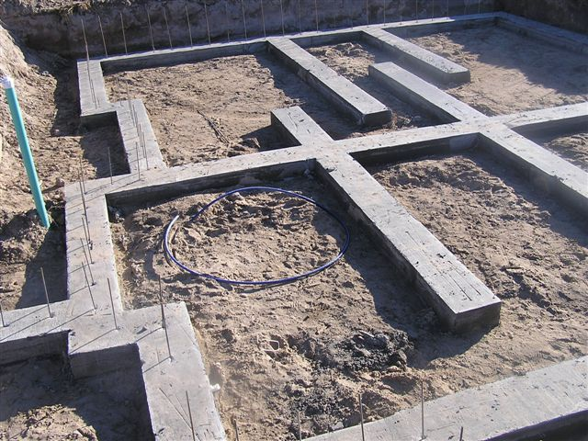
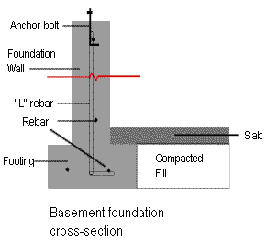
FOOTING
The portion of the foundation of a structure which transmits loads directly to the soil
FOUNDATION
Any part of a structure that serves to transmit the load to the earth or rock, usually below ground level

Slide 20
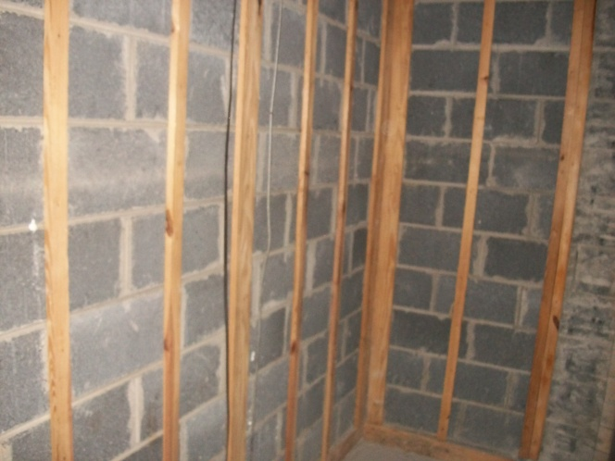
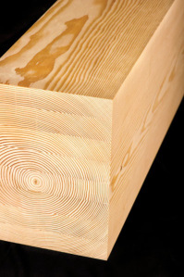
FURRING
Spacers such as wood or metal which are fastened to the joists, studs, walls, or ceilings of a building so that the finish surface may be leveled
GLUE LAMINATED TIMBER
A manufactured product consisting of four or more wood layers bonded together with adhesive

Slide 21
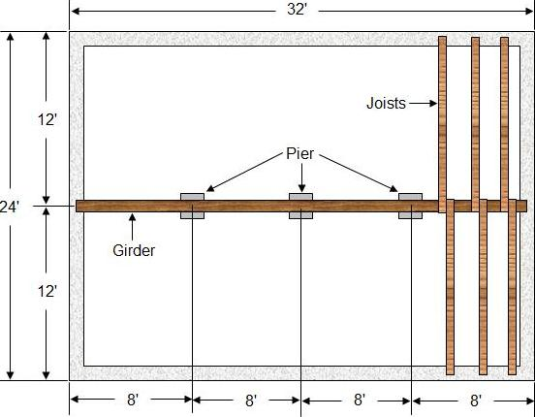
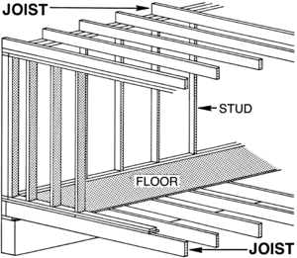
GIRDER
A large or principal beam of steel, reinforced concrete, or timber, used to support concentrated loads at isolated points along its length
JOIST
One of a series of parallel beams of timber, reinforced concrete, or steel used to support floor and ceiling loads, and supported in turn by larger beams, girders, or bearing walls

Slide 22
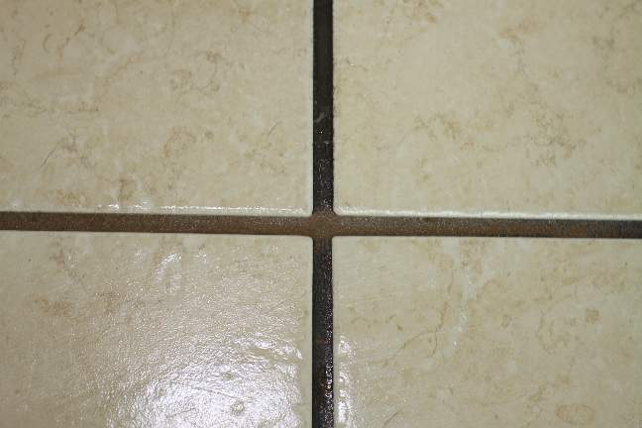
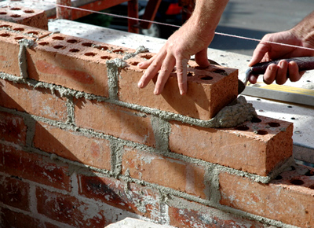
GROUT
Mortar containing a considerable amount of water so that it has the consistency of a viscous liquid, permitting it to be poured or pumped into joints, spaces, and cracks within masonry walls and floors, between pieces of floor or wall tile
MORTAR
A plastic mixture of cementitious materials with water and a fine aggregate that is troweled in place

Slide 23
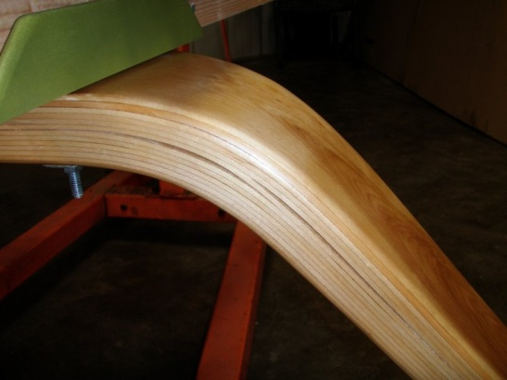
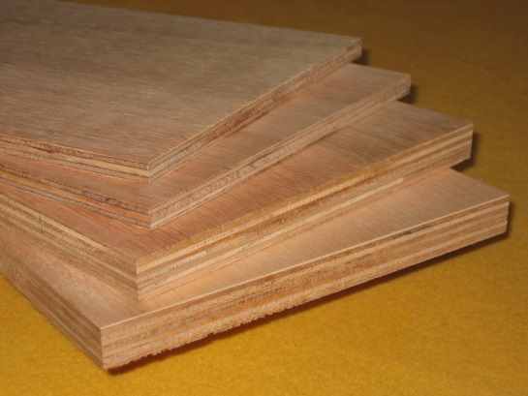
LAMINATED WOOD
Board or timber built up of piles which are joined together by gluing; usually the grain of all plies is parallel
PLYWOOD
Structural wood made of three or more layers of veneer, joined with glue

Slide 24
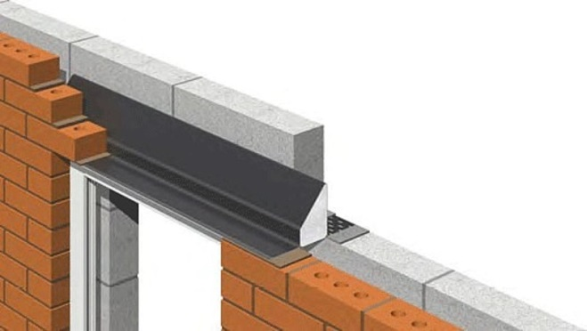
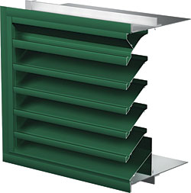
LINTEL
A horizontal structural member over an opening which carries the weight of the wall above it, usually of steel, stone, or wood
LOUVER
An assembly of sloping, overlapping blades or slats; may be fixed or adjustable; designed to admit air and/or light in varying degrees and to exclude rain and snow

Slide 25
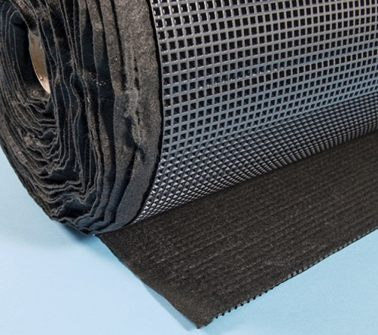
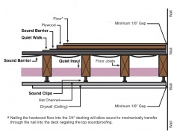
MEMBRANE
A weather-resistant flexible or semi-flexible covering consisting of alternate layers of felt and bitumen
SOUNDPROOFING
The elements of construction and the design features of a building which make it relatively impervious to sound transmission from one room to another or from outside the building to the inside

Slide 26
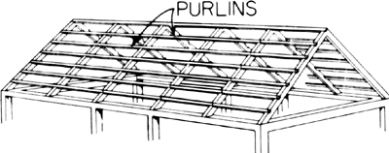
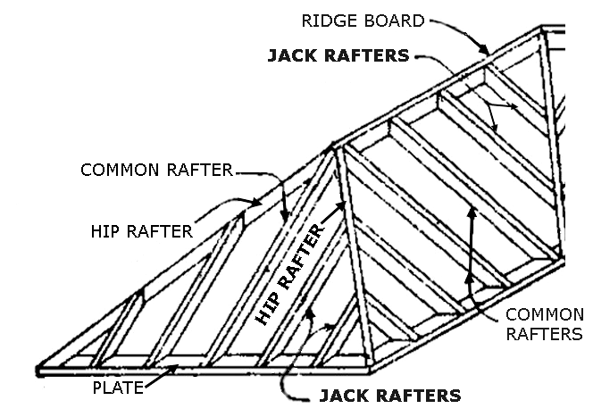
PURLIN
A piece of lumber laid horizontally on the principle rafters on which the roof covering is laid
RAFTER
One of a series of inclined members to which a roof covering is fixed

Slide 27
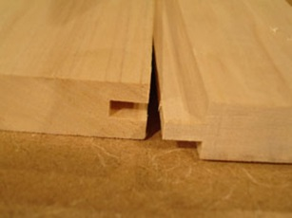
PSF
T&G
Pounds per Square Foot
Tongue and Grooved
PSI
Pounds per Square Inch
STC
Sound Transmission Class

Slide 28
QUOIN
A hard stone or brick used, with similar ones, to reinforce an external corner or edge of a wall; often distinguished decoratively from adjacent masonry
STANDING SEAM
Typically seen in metal roofing, a type of seam between adjacent sheets of material, made by turning up the edges to two adjacent sheets and then folding them over

Slide 29
RIDGE BEAM
A beam at the upper ends of the rafters, below the ridge of a roof
RIDGEBOARD
A longitudinal member at the apex of a roof which supports the upper ends of the rafters

Slide 30
RIGID INSULATION
A non-flexible foam board insulation used along foundation walls and under floor slabs
ROOF INSULATION
Insulation that is either laid or blown in to increase the thermal value of the structure. Insulation is either placed along the bottom chord of the roof trusses or installed between rafters where a finished space is provided

Slide 31
SHEATHING
The covering placed over exterior studding or rafters of a building; provides the base for the application of wall or roof cladding
ROOF DECK/
ROOF DECKING/
ROOF SHEATHING
The boards or sheet material, usually plywood, fastened to the roof rafters, onto which the roofing covering is laid

Slide 32
ROOF DRAIN
A drain designed to receive water colleting on the surface of a roof and to discharge it into a leader or a downspout
VAPOR BARRIER
A moisture-impervious layer or coating which prevents the passage of moisture or vapor into a material or structure

Slide 33
TRUSS
A structure composed of a combination of members, usually in some triangular arrangement so as to constitute a rigid framework
SCISSORS TRUSS
A type of truss used to support a pitched roof where the ties cross each other and are connected to the opposite rafters at an intermediate point along their length

Slide 34
PLATE
SILL PLATE
A horizontal board connecting and terminating posts, joists, rafters, etc
A horizontal timber, at the bottom of the frame of a wood structure, which rests on the foundation
TOP PLATE
The horizontal member of a frame building to which the rafters are fastened. Also the horizontal member at the top of the partition studs

Slide 35
DAMPPROOFING
A treatment of concrete or masonry to retard or prevent the passage or absorption of water
WATERPROOFING
A material, usually a membrane or applied compound, used to make a surface impervious to water

Slide 36
BEAM
WIDE FLANGE BEAM
A structural member whose prime function is to carry transverse loads, as a joist, girder, rafter, or purlin
A structural beam of rolled steel or concrete having the shape whose cross section resembles the letter H or I
BASEPLATE
A metal plate on which a column rests

