Slide 1
Architectural CAD I – IM230
Vocabulary

Slide 2
GROUP 4
Vocabulary

Slide 3
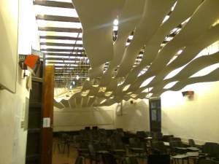
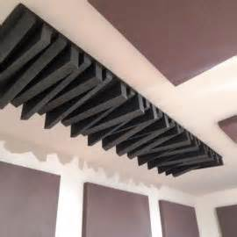
ACOUSTICAL CEILING
A ceiling covered by, or formed of, an acoustical material that is especially designed to absorb sound

Slide 4
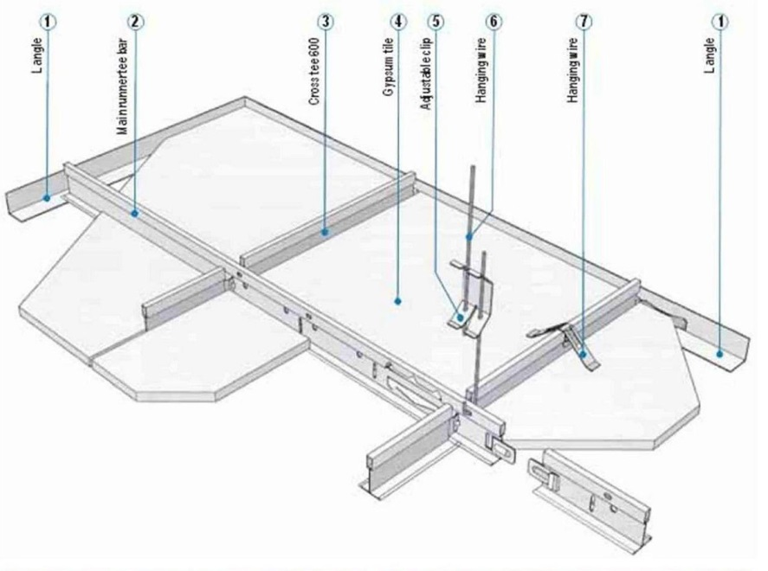
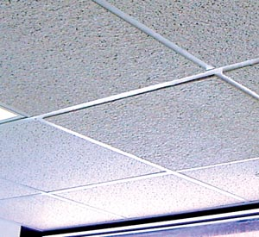
CEILING SUSPENSION SYSTEM
A system of metal members designed to support a suspended ceiling, typically an acoustical ceiling
SUSPENDED ACOUSTICAL CEILING
An acoustical ceiling which is suspended from the building structure above

Slide 5
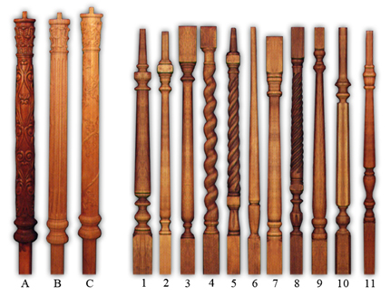
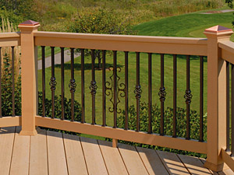
BALUSTER
A short vertical member, often circular in section, used to support a stair handrail or a guardrail
BALUSTRADE
An entire railing system including a top rail, balusters, and sometimes a bottom rail

Slide 6
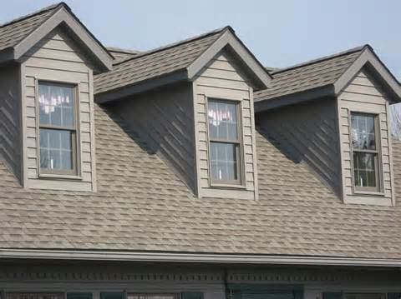
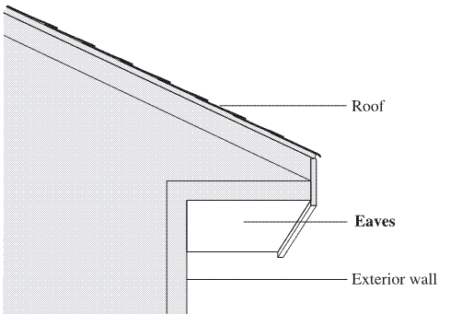
DORMER
A structure projecting from a sloping roof usually housing a window or ventilation louver
EAVES
The lower edge of a sloping roof; that part of a roof of a building which projects beyond the wall

Slide 7
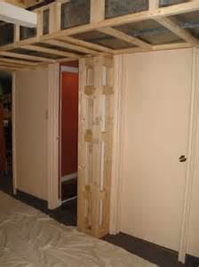
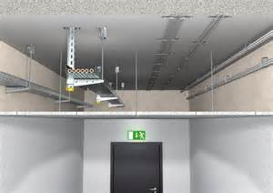
BULKHEAD
A structure covering an opening, shaft, or service equipment that provides adequate headroom
FALSE CEILING
A secondary ceiling formed to provide space for services (such as ductwork, piping, wiring) above it

Slide 8
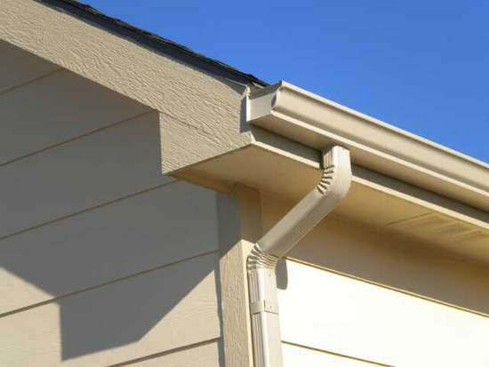
DOWNSPOUT
A vertical pipe used to conduct water from a roof drain or gutter to the ground
GUTTER
A shallow channel of metal immediately below and along the eaves of a building to catch and carry off rainwater from the roof

Slide 9
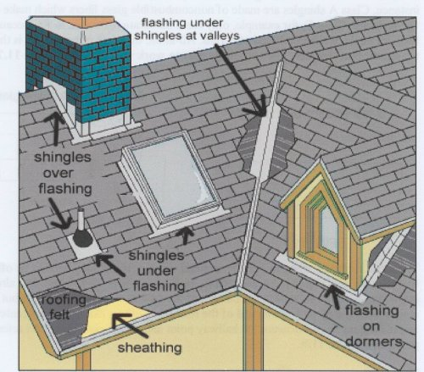
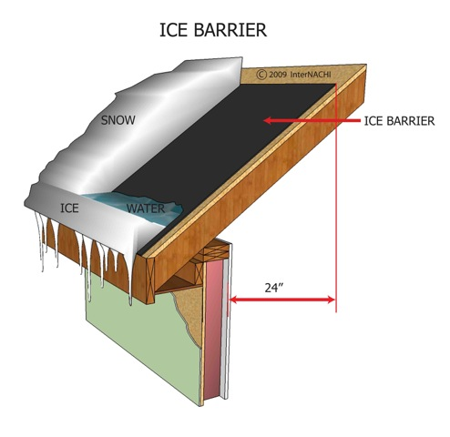
FLASHING
A thin impervious material place in construction (e.g., in mortar joints, around windows and doors, roof penetrations) to prevent water penetration and/or provide water drainage
ICE DAM SHIELD
A rubber membrane installed under the roofing material to prevent the build up of snow and ice at the eaves of a sloping roof

Slide 10
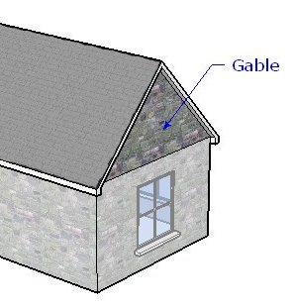
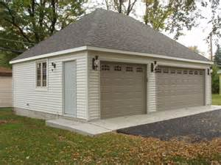
GABLE
The vertical triangular portion of the end of a building having a double-sloping roof
HIP
The external angle at the junction of two sloping roofs or sides of a roof

Slide 11
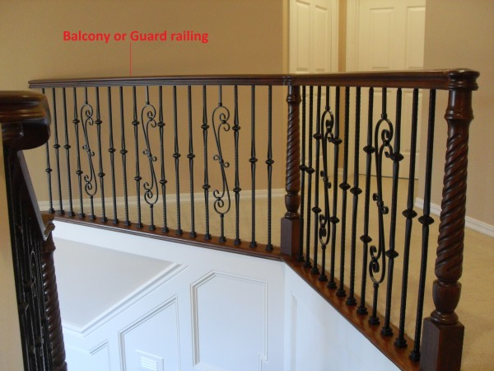
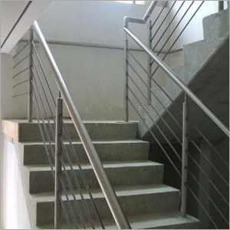
GUARDRAIL
A railing that is usually installed along open sided stairs or raised areas, where the floor is more than 30” below, that prevents persons from falling
HANDRAILING
Any openwork construction or rail used as a barrier or the like

Slide 12
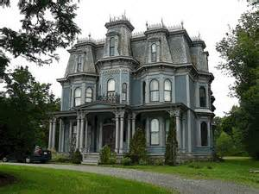
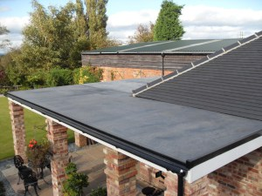
MANSARD
A roof having a double slope on all four sides, the lower being much steeper
RUBBER ROOF
A highly resilient material, typically used to cover flat or low sloped roofs

Slide 13
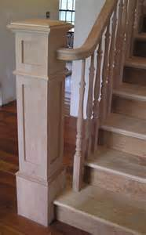
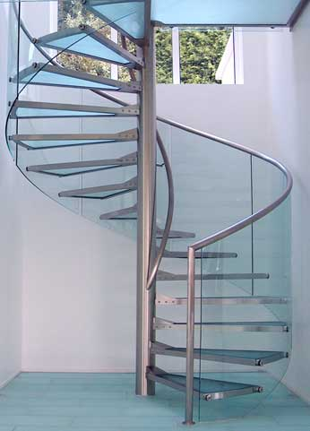
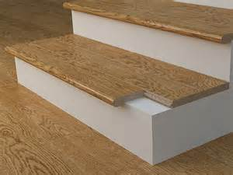
NEWEL
The central post or column around with the steps of a circular staircase wind, and which provides support for the staircase. Also the ending post on the open sided staircase where the handrail terminates into
NOSING
The prominent, usually rounded, horizontal edge which extends beyond an upright face below; as the projection of a tread beyond a riser

Slide 14
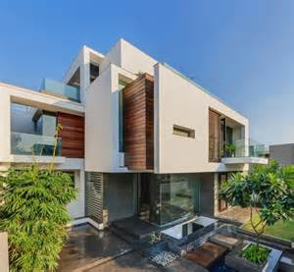
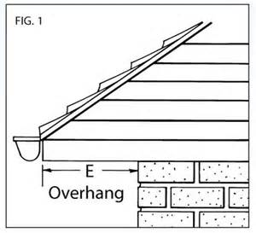
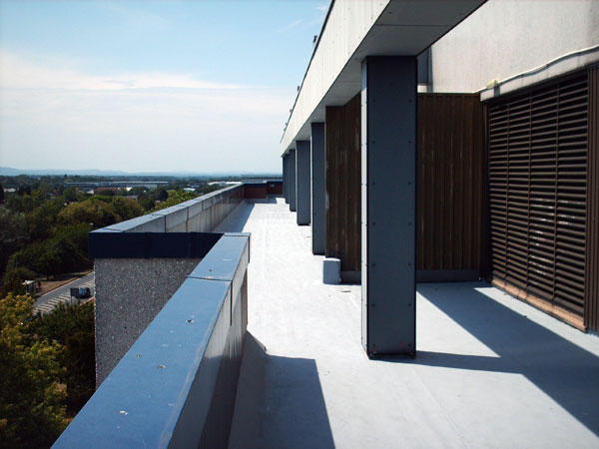
OVERHANG
The projection of an upper story or beyond a story immediately below
PARAPET
A low guarding wall at any point of sudden drop, as at the edge of a roof

Slide 15
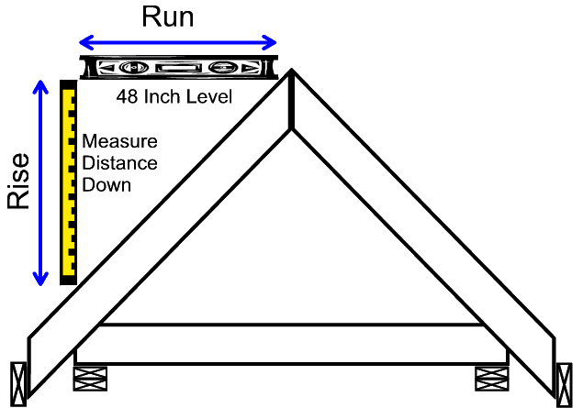
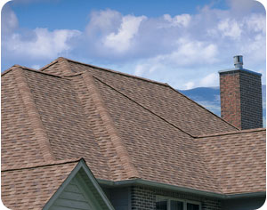
PITCH/SLOPE
The slope of a roof, usually expressed as a ratio of vertical rise to horizontal run
RIDGE
The horizontal line at the junction of the upper most edges of two sloping roof surfaces

Slide 16
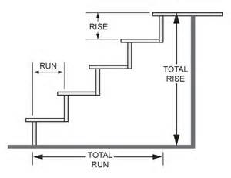
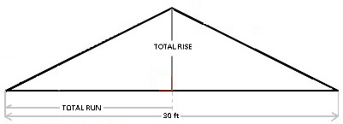
RISE
The height of a flight of stairs from landing to landing; the height between successive treads of a stair
RUN
The horizontal distance from the face of a wall to the ridge of the roof. Additionally, it is the width of a single stair tread

Slide 17
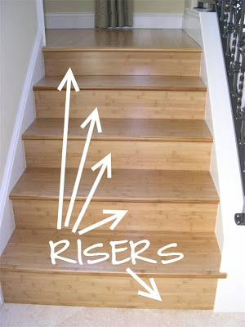
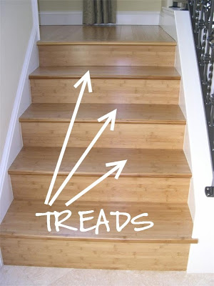
RISER
The vertical face of a stair step
TREAD
The horizontal part of a step; includes the nosing

Slide 18
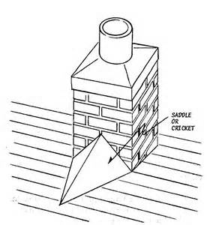
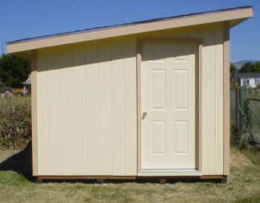
SADDLE/CRICKET
A small saddle-shaped projection on a sloping roof; used to divert water around an obstacle such as a chimney
SHED ROOF
A roof shape having only one sloping plane

Slide 19
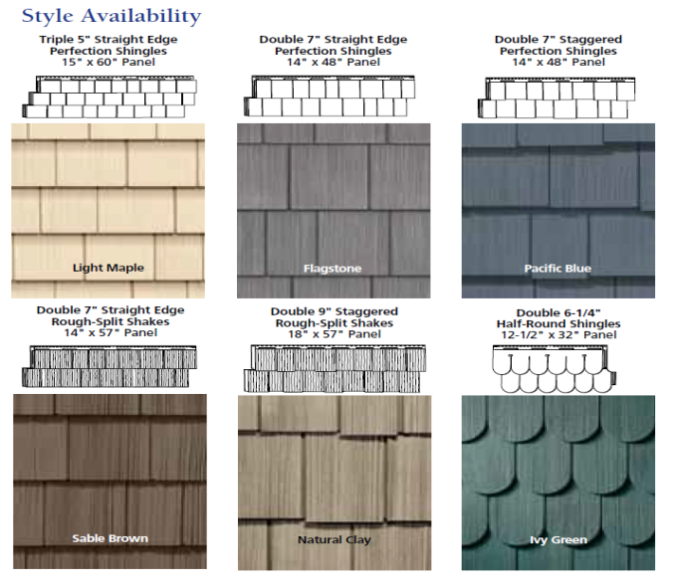
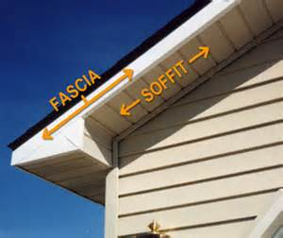
SHINGLE
A roofing material of cut stock lengths, widths, and thickness; used as an exterior covering on sloped roofs and side walls; applied in an overlapping fashion
SOFFIT
The exposed undersurface of any overhead component of a building, such as an arch, balcony, beam, roof eave

Slide 20
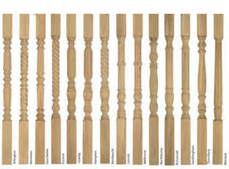
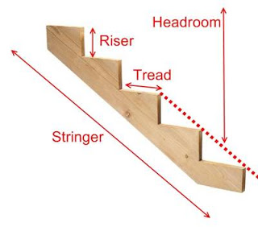
SPINDLE
A short turned part as in a baluster
STRINGER
An inclined board which supports the end of the steps

Slide 21
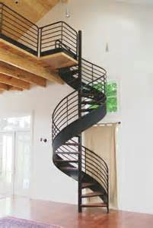
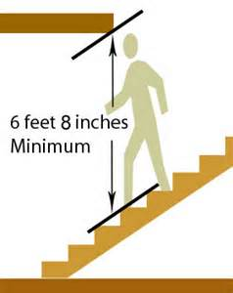
SPIRAL STAIR
A flight of stairs, circular in plan, whose treads wind around a central newel
STAIR HEADROOM
The clear vertical clearance height measured from the nosing of a stair tread to any overhead obstruction

