Slide 1
Architectural CAD I – IM230
Vocabulary

Slide 2
GROUP 3
Vocabulary

Slide 3
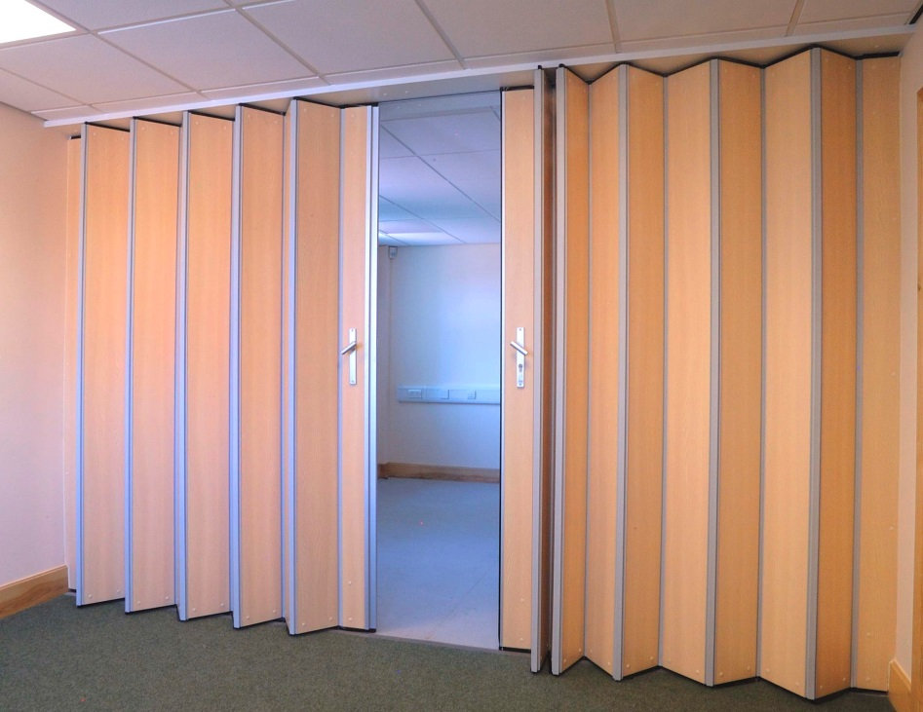
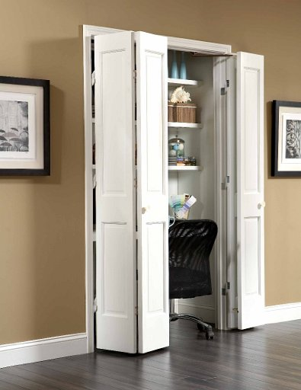
ACCORDION PARTITION
A fabric-faced partition which is hung from an overhead track and folds back like the bellows of an accordion
BI-FOLDING DOOR
A door having two pairs of leaves that are hinged together, with one side pivoted to the jamb, while the other side slides open and closed in the overhead track

Slide 4
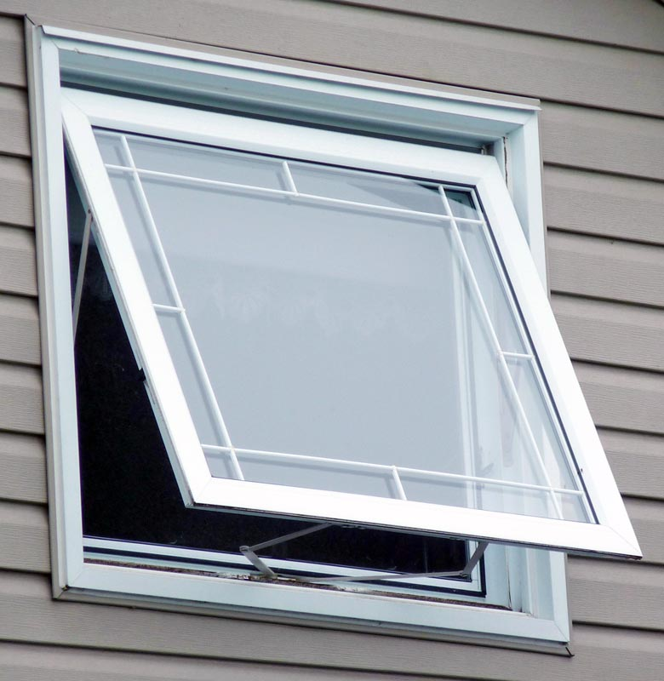
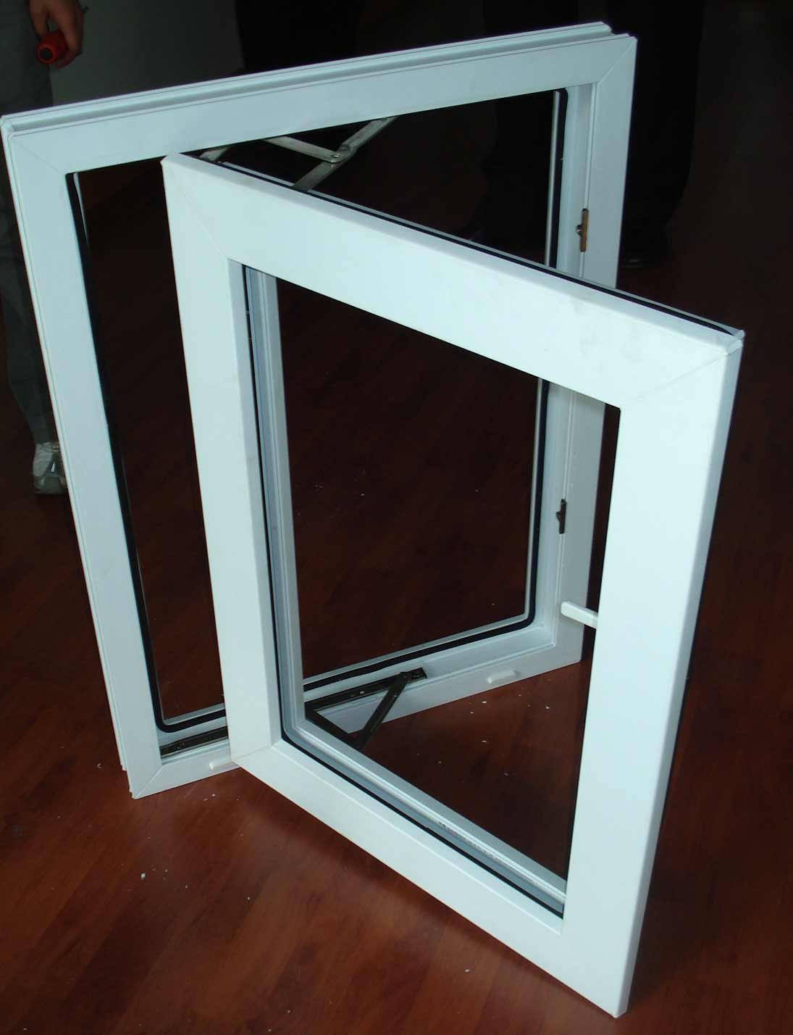
AWNING WINDOW
A window that the top horizontal sash is top-hinged and the bottom sash swings inward or outward
CASEMENT WINDOW
A window that’s side sash swings open along the entire length

Slide 5
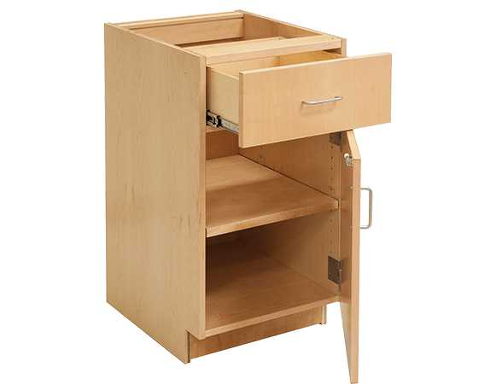
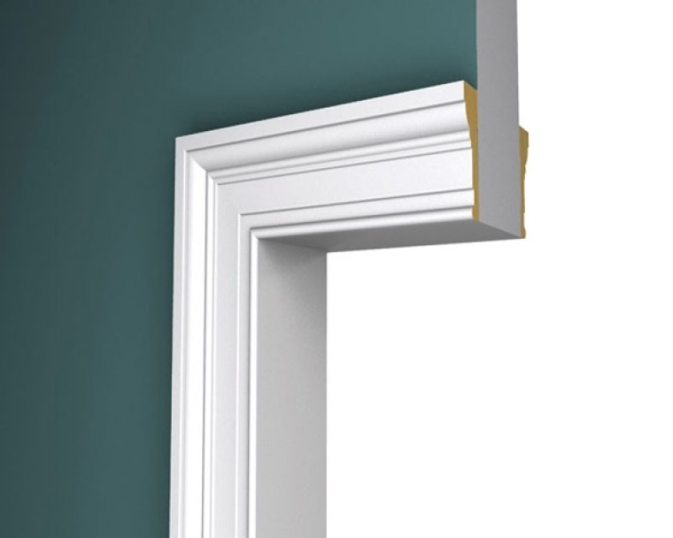
CASEWORK
The aggregate assembled parts (including framework, finish, doors, drawers, etc.) which make up a case or cabinet
CASING
The exposed trim molding, framing, or lining around a door or window

Slide 6
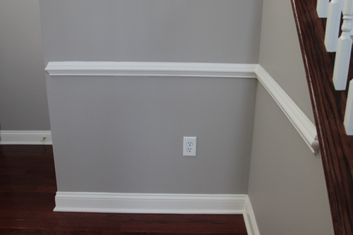
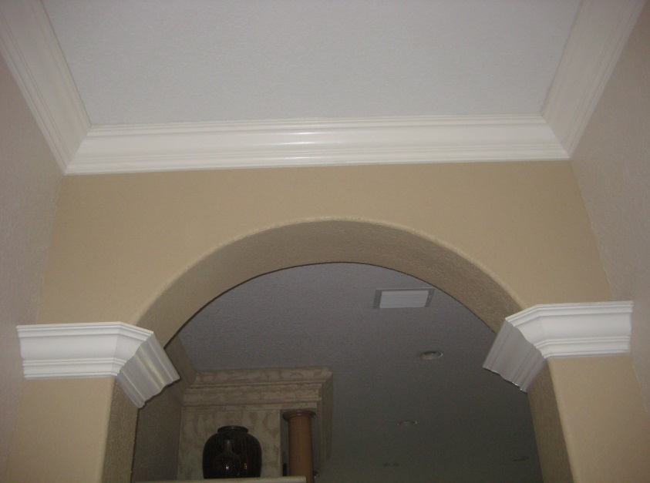
CHAIR RAIL
A horizontal strip usually of wood, affixed to the wall at a height which prevents the backs of chairs from damaging the wall surface
CROWN MOLDING
Any molding forming the crowning or finishing member of a structure or along a ceiling

Slide 7
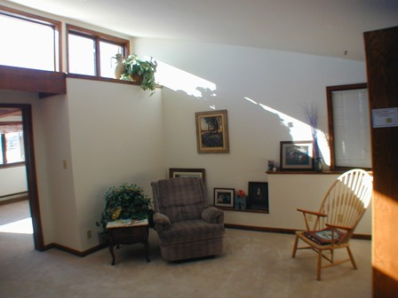
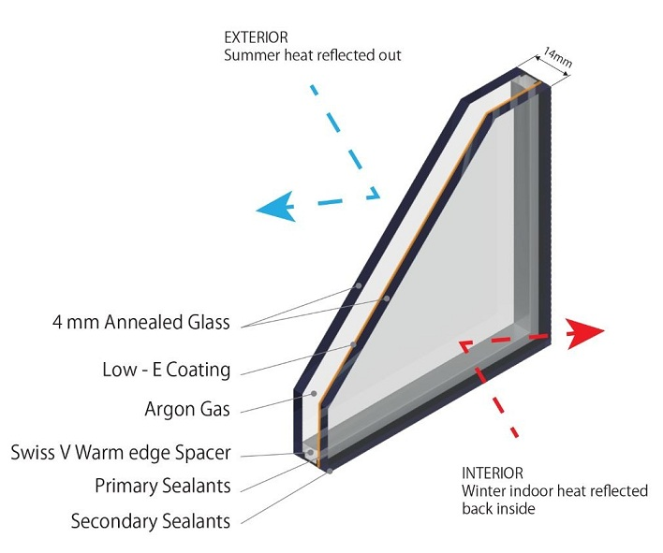
CLERESTORY
An upper zone of wall pierced with windows that admit light into the room
DOUBLE GLAZING
Two panes of glass, usually parallel, with an air space between; used to provide increased thermal and/or sound insulation

Slide 8
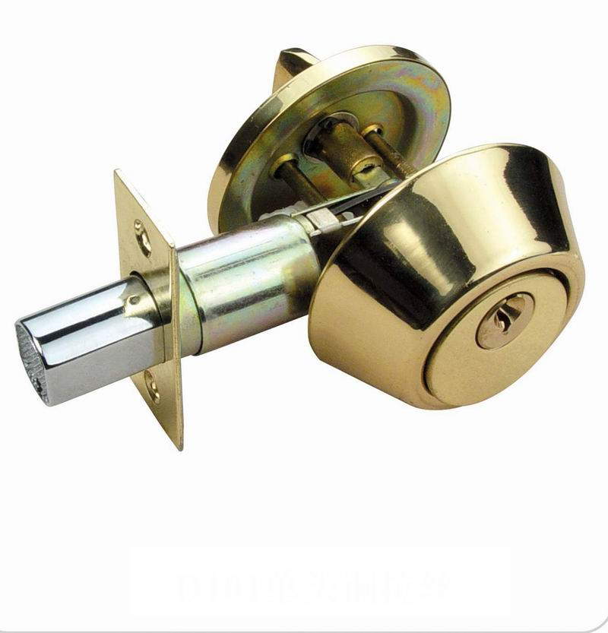
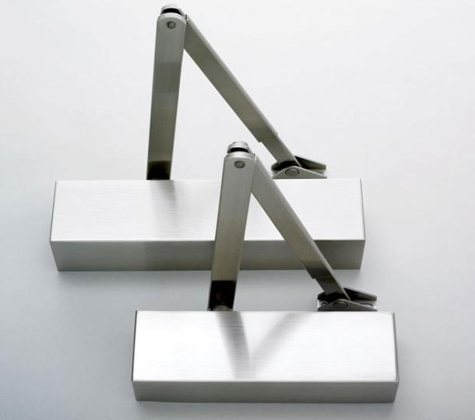
DEADBOLT
A type of door lock which is operated by the door key or turning piece
DOOR CLOSER
A device, containing a spring, for controlling the speed to automatically close a door

Slide 9
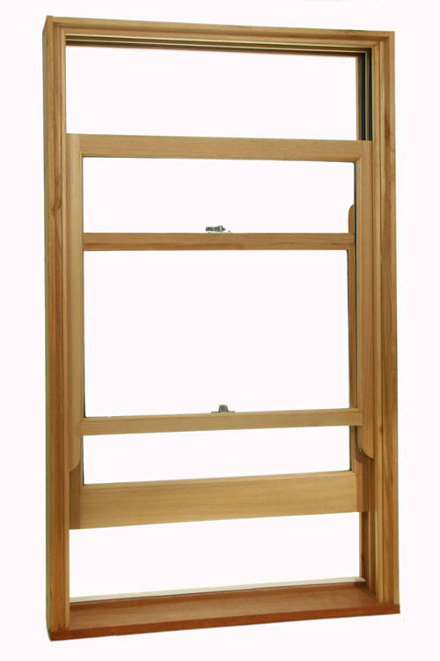
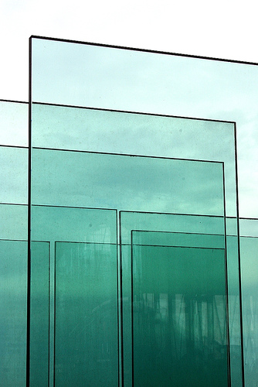
DOUBLE HUNG WINDOW
A window having two vertically sliding sashes, each closing a different part of the window
GLAZING
The glass surface of a glazed opening

Slide 10
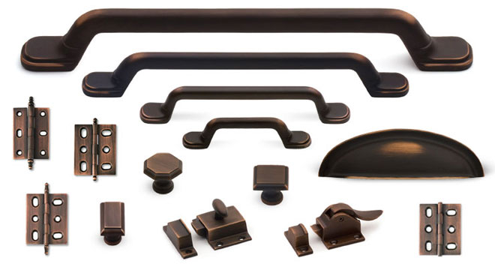
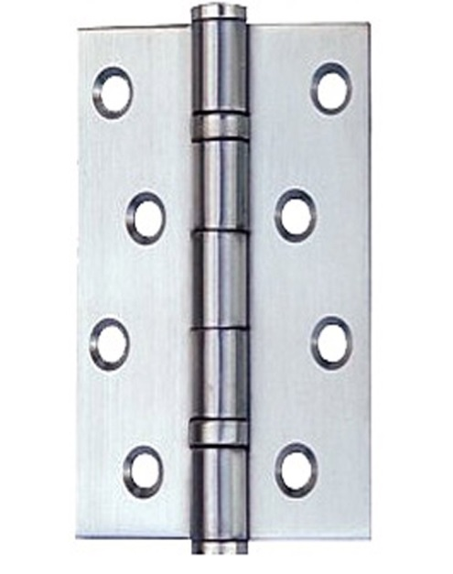
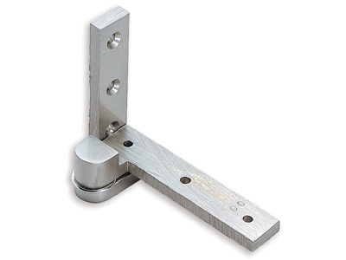
FINISH HARDWARE
Hardware, such as hinges, locks, knobs, etc., that has a finished appearance as well as a function, which are usually used with doors, windows, and cabinets
HINGE
A movable joint used to attach, support, and turn a door about a pivot

Slide 11
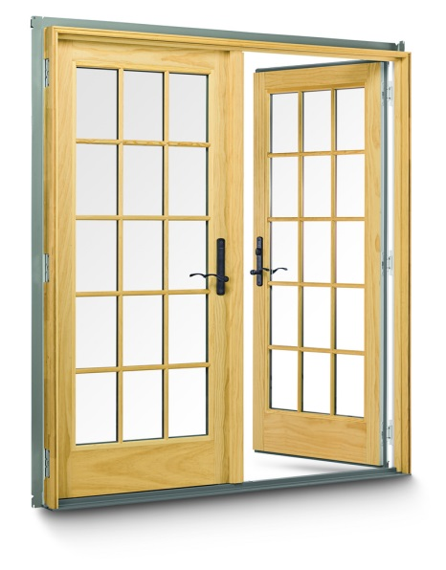
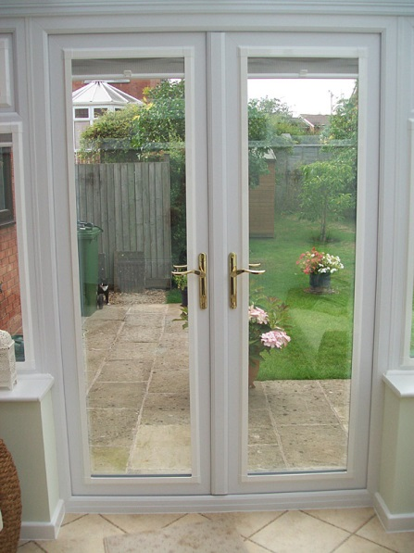
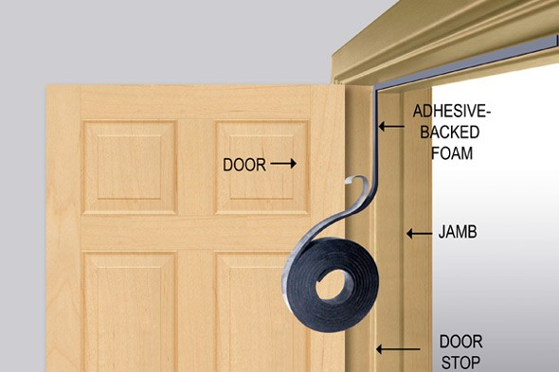
FRENCH DOORS
A door having a top and bottom rail and stiles, which has glass panes throughout its entire length
GASKET/WEATHER STRIPING
A continuous strip of resilient material attached to a door or door frame to provide a tight seal between the door and frame, it also provide a barrier from the weather, light, and sound

Slide 12
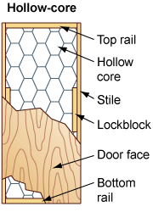
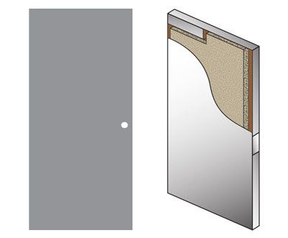
HOLLOW CORE DOOR
A flush door of hollow-core construction
HOLLOW METAL DOOR
A flush metal door, fabricated of sheet steel and reinforced by light metal channels; sometimes filled with a light filler material

Slide 13
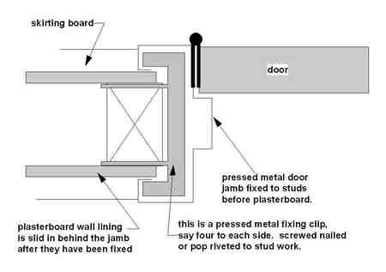
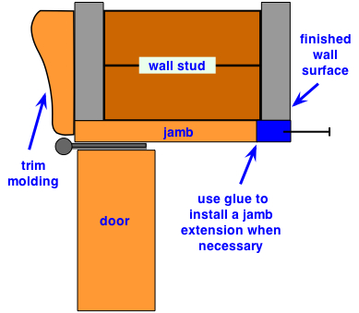
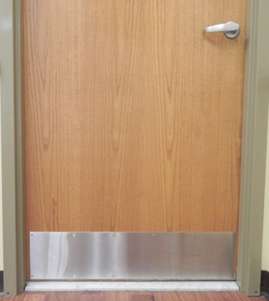
JAMB
A vertical member at either side of a door or window frame
KICKPLATE
A protective plate applied on the lower rail of a door to prevent marring

Slide 14
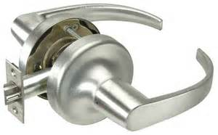
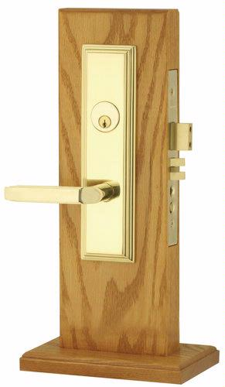
LATCH
A simple fastening device having latch bolt, but not a dead bolt, contains no provisions for locking with a key; usually operable from both sides
LOCKSET
A complete lock system including the basic locking mechanism and all the accessories, such as knobs, levers, plates, etc

Slide 15
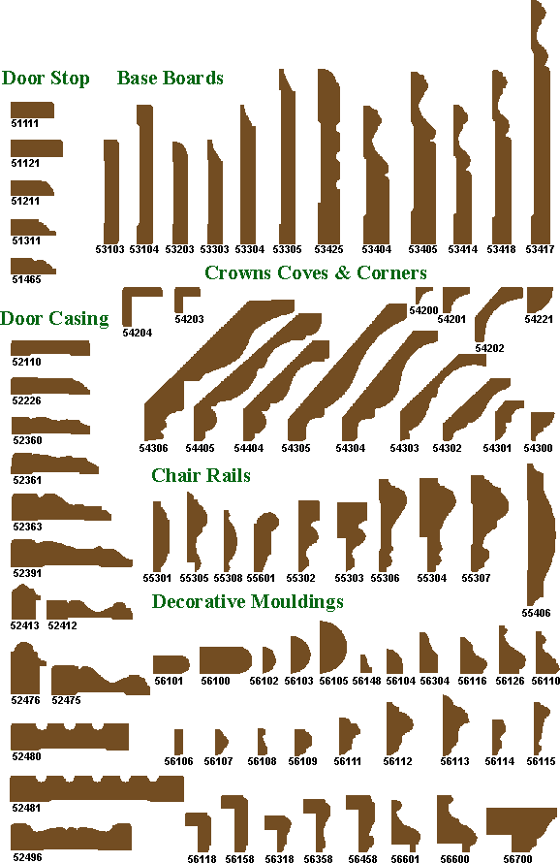
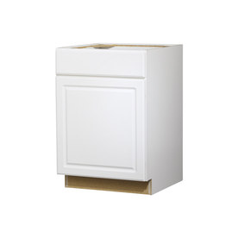
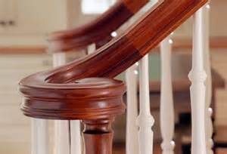
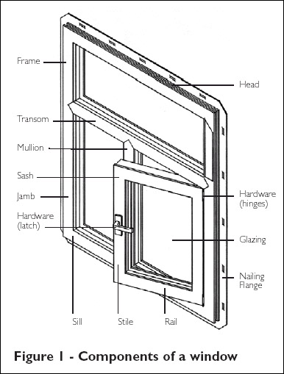
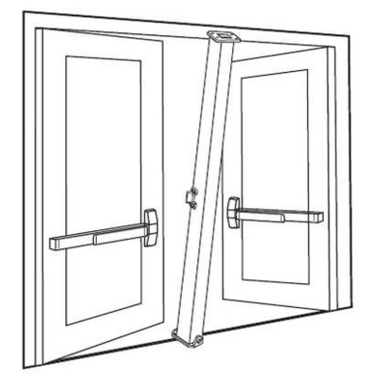
MILLWORK
Ready-made products which are manufactured at a wood-planning mill or woodworking plant: moldings, doors, door frames, window sashes, stair work, cabinets, etc
MULLION
A vertical member separating (and often supporting) window, door, or panels set in series

Slide 16
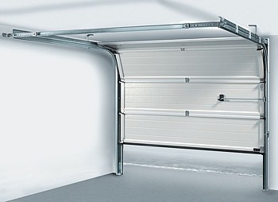
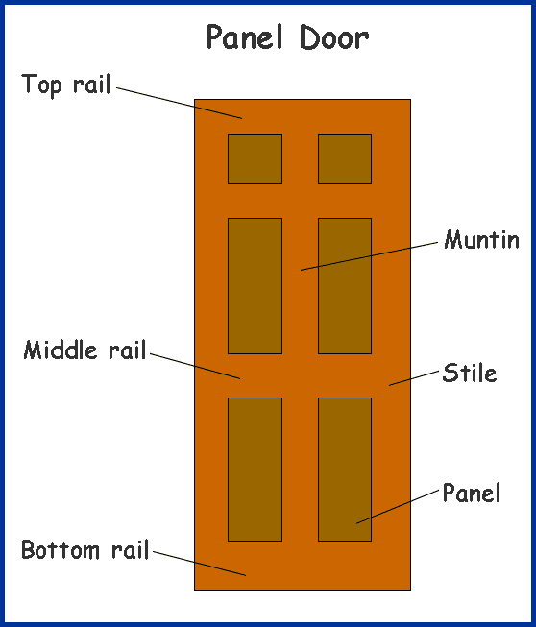
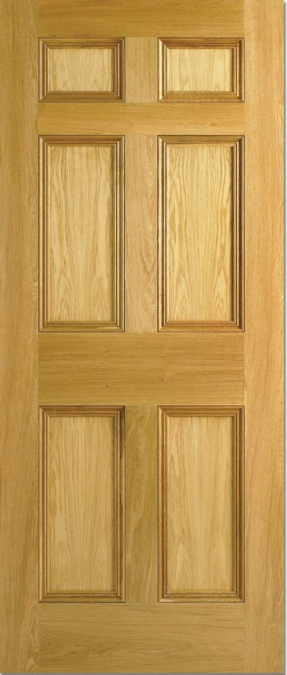
OVERHEAD DOOR
A door that either swings up or rolls up, which when open, assumes a horizontal position above the door opening
PANEL DOOR
A door having stiles, rails and sometimes mutins which form one or more frames around recessed panels

Slide 17
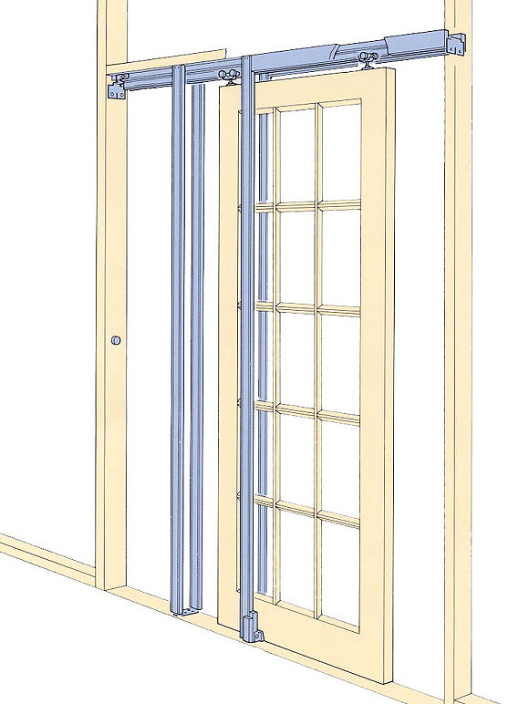
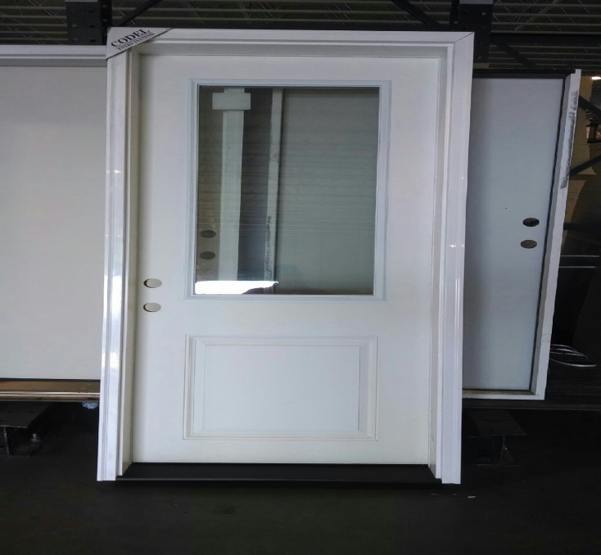
POCKET DOOR
A door that recesses into a wall
PREHUNG DOOR
An assembly consisting of a door on its frame, together with all necessary hardware and trim, ready for installation

Slide 18
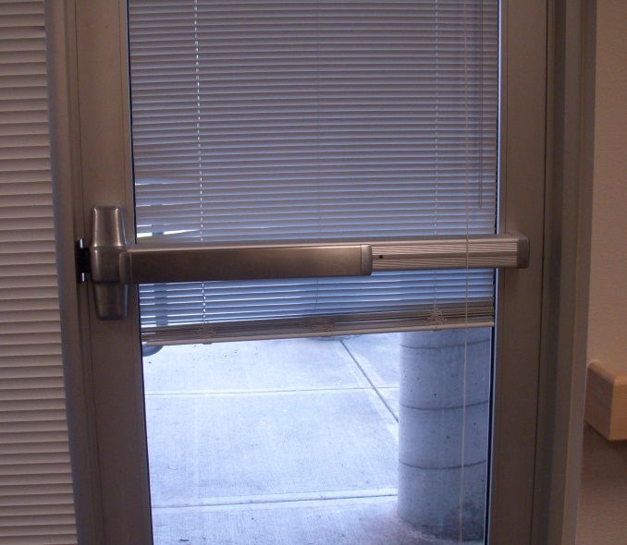
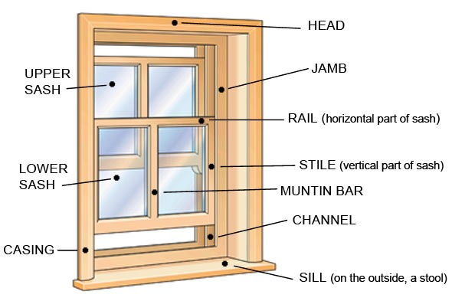
PUSH BAR/PANIC
A heavy bar fixed across a glazed door used to open or closed the door, while providing protection for the glass
SASH
Any framework of a window

Slide 19
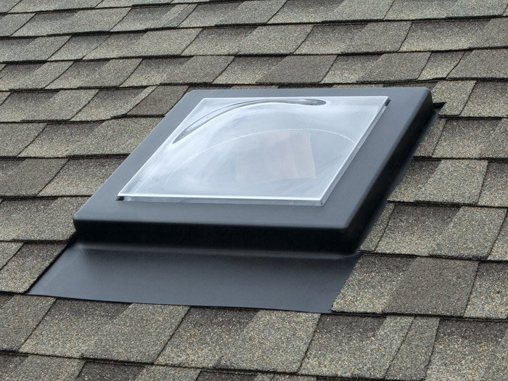
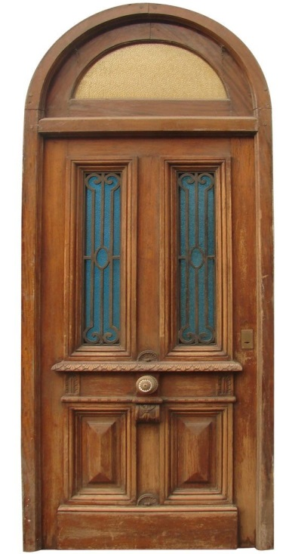
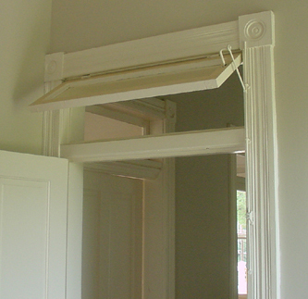
SKYLIGHT
An opening which is glazed with a transparent or translucent material that is located in the roof
TRANSOM
A horizontal bar of wood or stone across a window or door. Also, a window located above a door

Slide 20
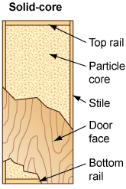
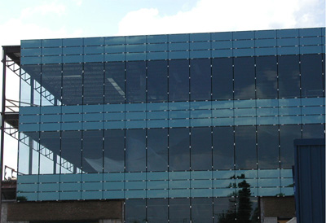
SOLID-CORE DOOR
A door having a core of solid wood or mineral composition
SPANDREL GLASS
An opaque glass used in windows and curtain walls to conceal internal construction

Slide 21
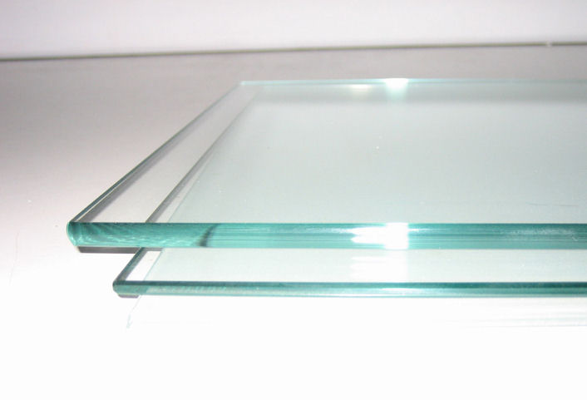
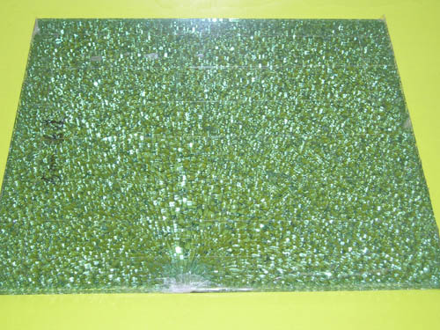
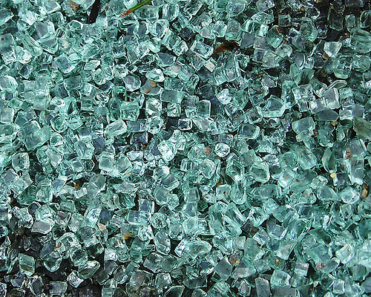
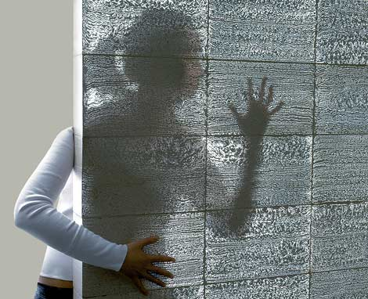
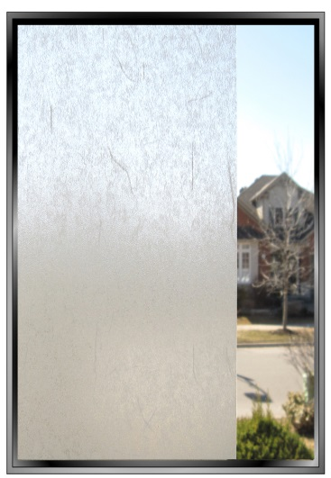
TEMPERED GLASS
Glass having two or four times the strength of ordinary glass as a result of being prestressed by heating and then suddenly quenched
TRANSLUCENT
A material that transmits light but diffuses is sufficiently so that an image cannot be seen through the material clearly

Slide 22
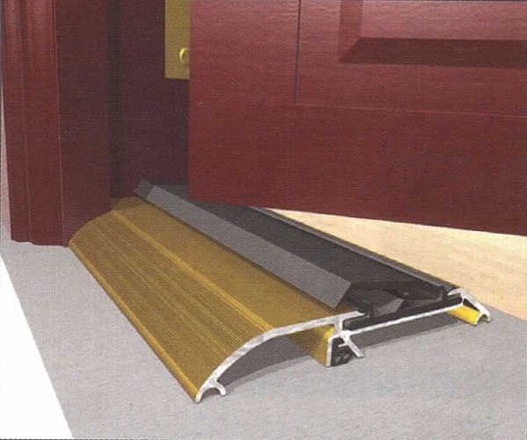
THRESHOLD
A strip fastened to the floor beneath a door to cover the joint where two types of flooring material meet; may provide weather protection at exterior doors
TOE KICK
A space provided, typically in cabinetry, for toe space

Slide 23
TRIM
The visible woodwork or moldings of a room, such as the baseboards, chair rail, crown molding, door and window casing, etc
WAINSCOT
A decorative or protective facing applied to the lower portion of an interior partition or wall

