Slide 1
Architectural CAD I – IM230
Vocabulary

Slide 2
GROUP 2
Vocabulary

Slide 3
ADA
AIA
Americans with Disabilities Act
American Institute of Architects
P.E.
Professional Engineer

Slide 4
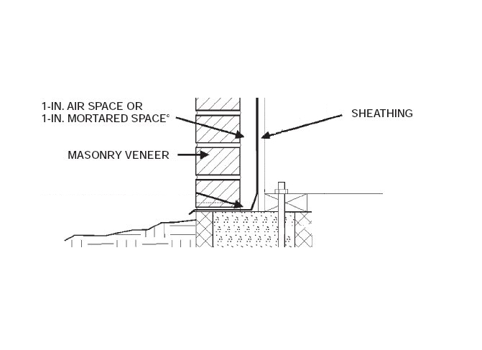
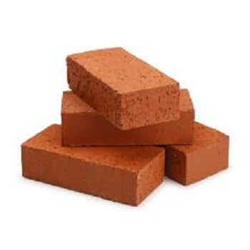
AIR SPACE
A void space between building materials
BRICK
A solid or hollow masonry unit of clay or shale, molded into a rectangular shape

Slide 5
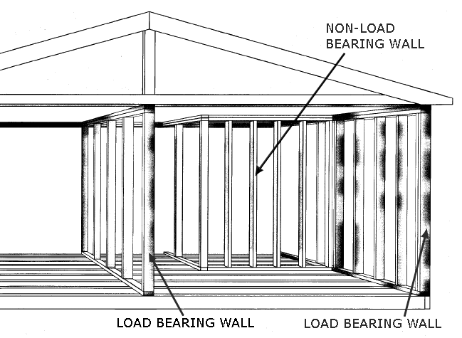
BEARING WALL
LOAD-BEARING PARTITION
A wall capable of supporting an imposed load
A partition capable of supporting an imposed load in addition to its own weight
NONBEARING WALL
A wall supporting no load other than its own weight

Slide 6
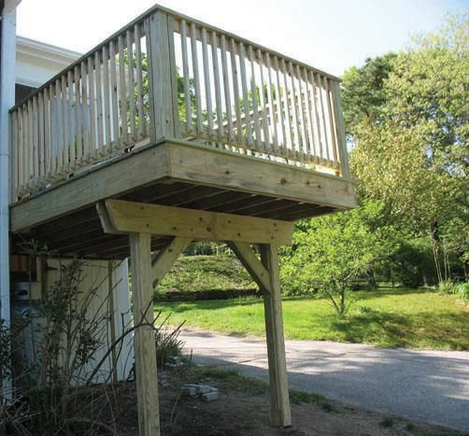
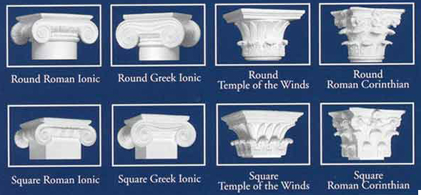
CANTILEVER
A beam, girder, truss, or other structural member which projects beyond its supporting wall or column
CAPITAL
The topmost member of a column

Slide 7
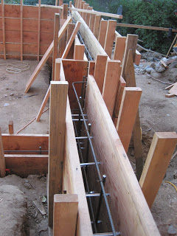
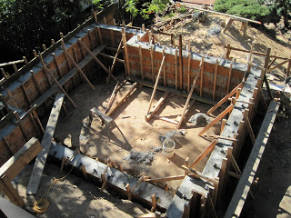
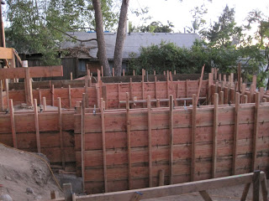
CAST-IN-PLACE CONCRETE
Concrete which is deposited in the place where it is required to harden as part of the structure

Slide 8
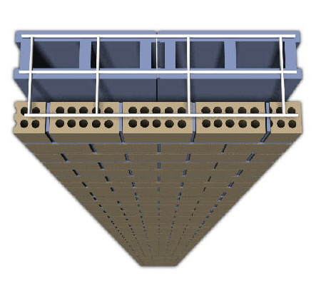
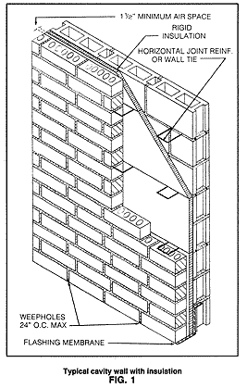
CAVITY WALL
An exterior wall, usually masonry, consisting of an outer and inner with separated by a continuous air space, but connected together by wire or sheet-metal ties. The dead air space provides improved thermal insulation

Slide 9
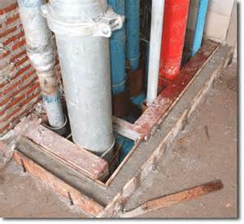
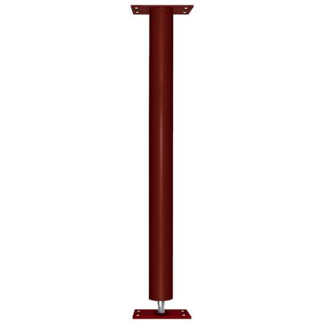
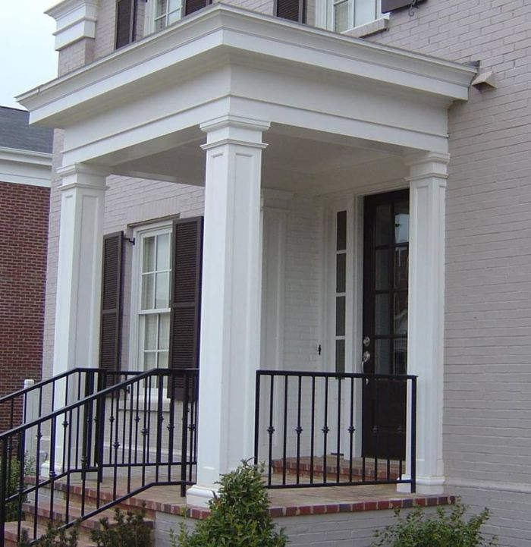
CHASE/SHAFT
A continuous recess built into a wall to receive pipes, conduit, and/or ductwork
COLUMN
A vertical structural member that supports a load which acts in the direction of its longitudinal axis

Slide 10
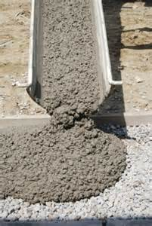
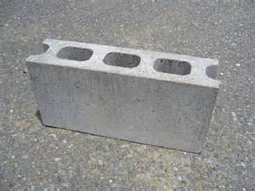
CONCRETE
A composite material which consists essentially of a binding medium within which are embedded particles or fragments of aggregate
PRECAST CONCRETE
A concrete member that is cast and cured in other than its final position

Slide 11
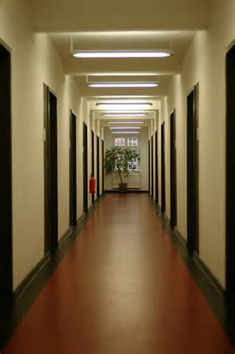
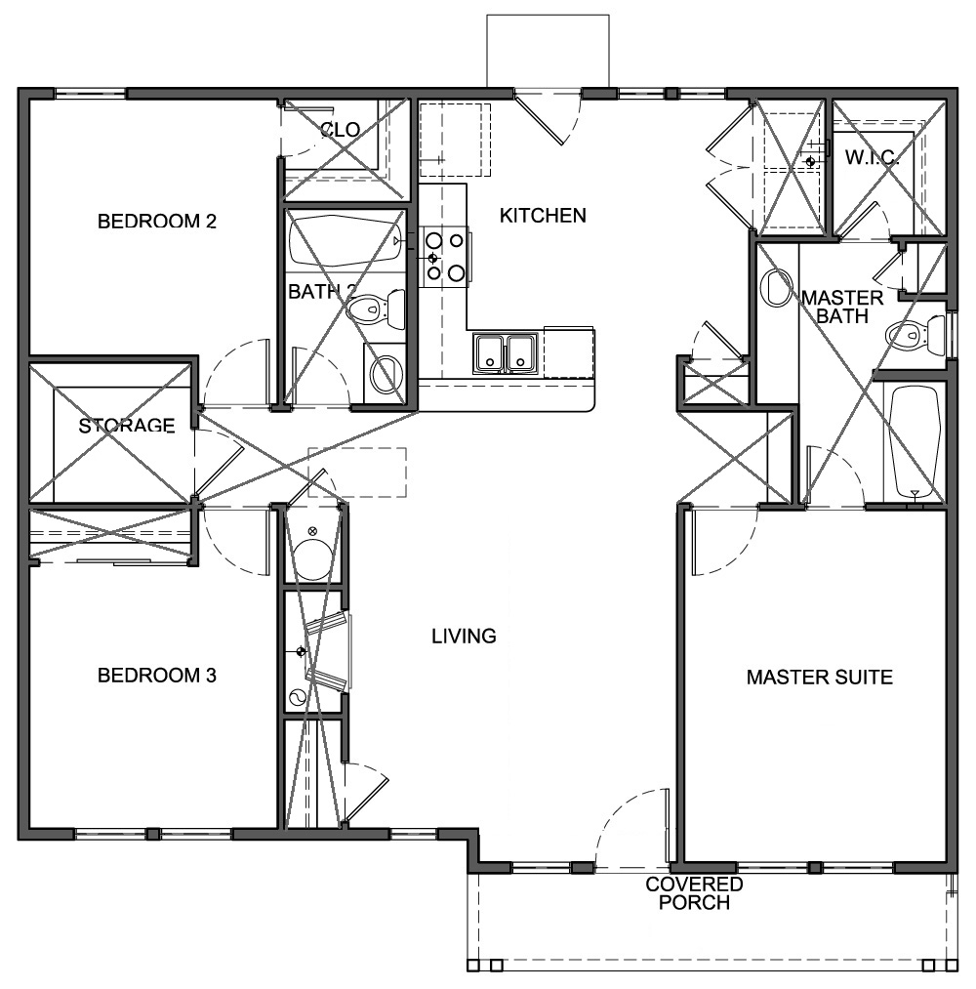
CORRIDOR
A long interior passageway providing access to several rooms
HABITABLE ROOM
A space used for living, sleeping, eating, or cooking, or combinations thereof, but not including bathrooms, closets, halls, storage rooms, utility and similar spaces

Slide 12
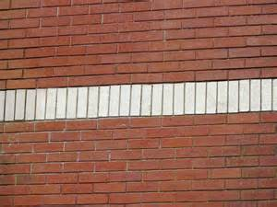
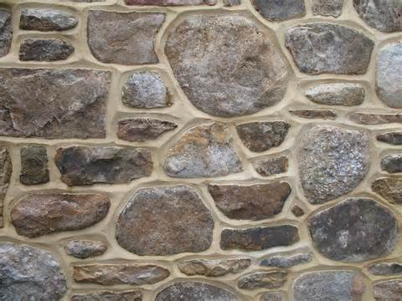
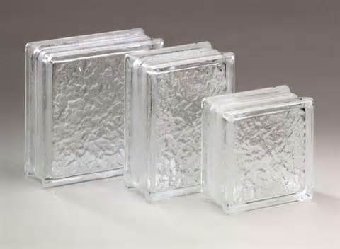
COURSE
A layer of masonry units running horizontally in a wall
MASONRY UNIT
A natural or manufactured building unit of stone, clay, glass, etc

Slide 13
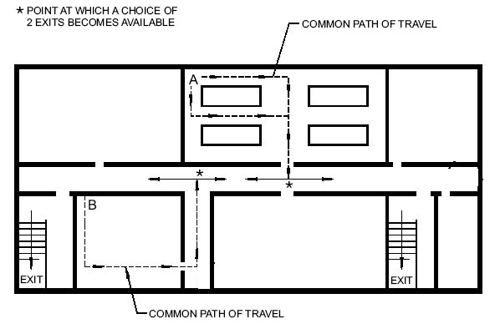
EXIT
The portion of a means of egress which is separated from the rest of a building by walls, floors, doors, or other means and which provides a reasonably protected path of escape for the occupants of a building in the event of a fire

Slide 14
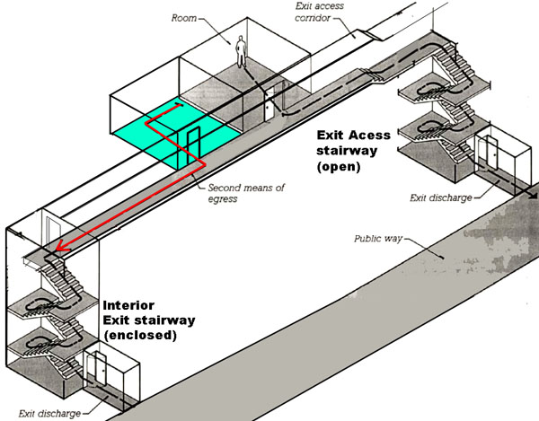
EXIT ACCESS
EXIT DISCHARGE
The portion of the means of egress that leads to an exit
The portion of the means of egress between the termination of the exit at the exterior of the building and the ground level
EXIT CORRIDOR
A corridor or enclosed passageway connecting a stairway, fire tower, or other required exit with a street or alley

Slide 15
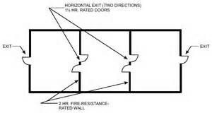
HOIZONTIAL EXIT
A means of passage from one building into another building occupied by the same tenant, or from one section of a building to another section of the same building occupied by the same tenant, through a separation wall having a specified fire-resistance rating

Slide 16
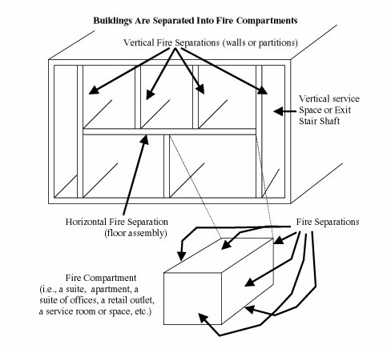
FIRE AREA
FIRE PARTITION
Any area in a building, encompassed by fire walls and/or exterior walls, within which a fire would be confined because of the surrounding fire-resistant construction
A partition which has a fire-resistant rating, but does not qualify as a fire wall, and acts as a barrier against the spread of fire within a building
FIRE SEPARATION
A floor or wall having a fire-resistance rating and acts as a barrier against the spread of fire within a building

Slide 17
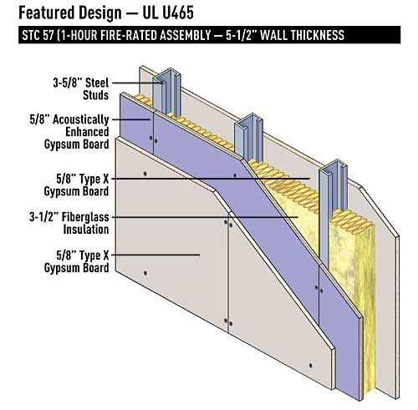
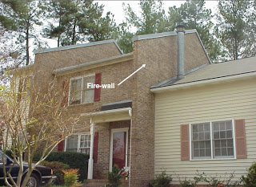
FIRE-RESISTANCE RATING
The time in hours that a material or construction can withstand fire exposure
FIRE WALL
An interior or exterior wall having sufficiently high fire resistance and structural stability, under conditions of fire, to restrict its spread to adjoining areas or buildings, usually extending from the lowest floor to about 3’ above the roof

Slide 18
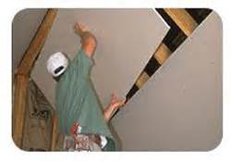
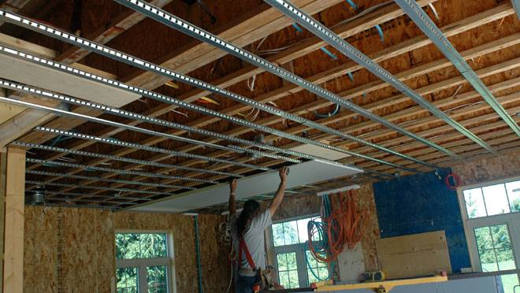
GYPSUM WALLBOARD/DRYWALL
A rigid sheet composed of gypsum, or other materials; fastened to the frame of a building to provide an interior surface finish. Typically the standard used in wallboard installation
RESILIENT CHANNEL
A fabricated metal strip used for attaching gypsum board to studs or joists without a solid connection so as to reduce the transmission of noise and vibration

Slide 19
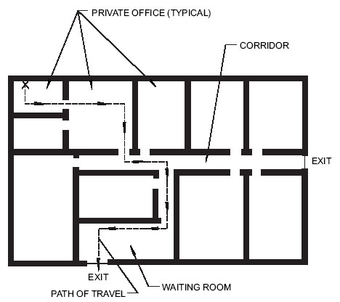
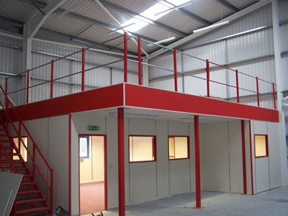
MEANS OF EGRESS
A continuous path of travel from any point in a building or structure to the outside at ground level
MEZZANINE
A low-ceilinged story or extensive balcony, usually constructed next above the ground floor

Slide 20
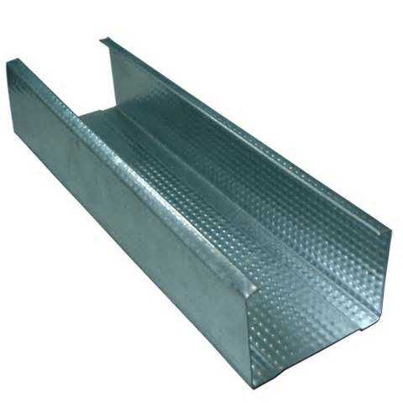
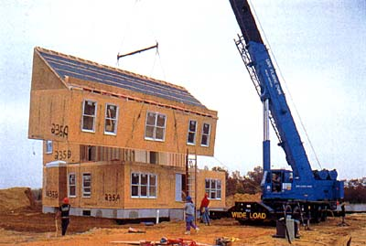
NONCOMBUSTIBLE
A material of which no part will ignite and burn when subjected to fire
PREFAB
A factory-built product that is assembled off-site and delivered to the site for installation

Slide 21
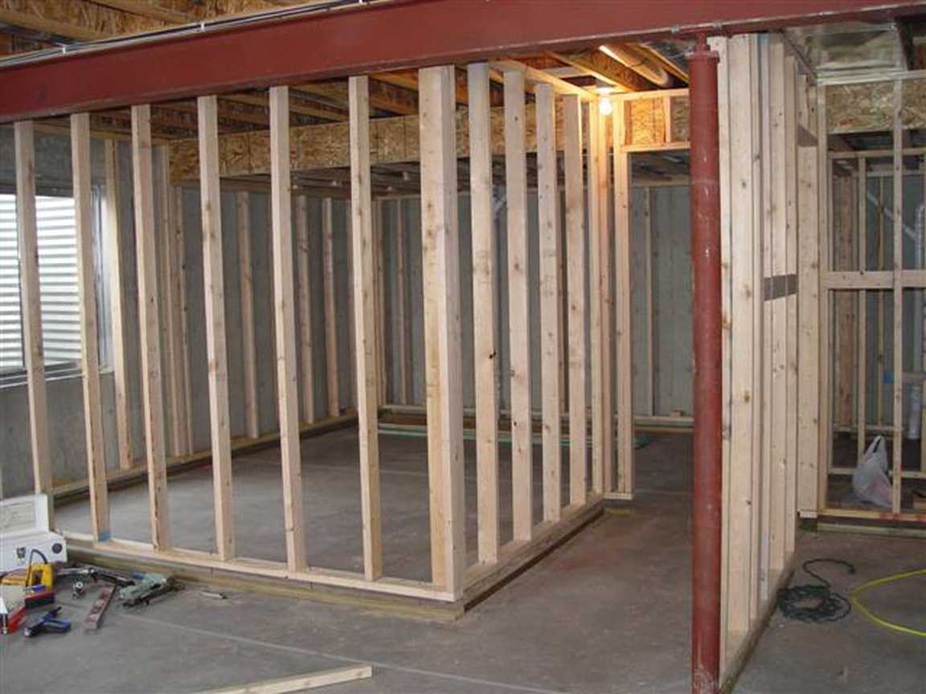
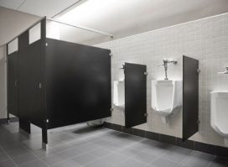
PARTITION
A dividing wall within a building
TOILET PARTITION
Panels that create an enclosure around a plumbing fixture, usually toilets and urinals

Slide 22
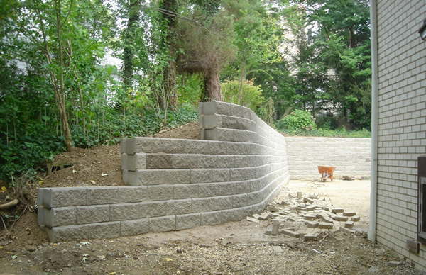
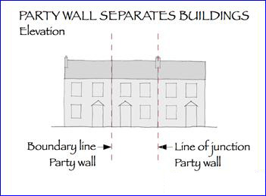
RETAINING WALL
A wall, either free standing or laterally braced, that bears against an earth or other fill surface and resists lateral forces
PARTY WALL
A wall used jointly by two parties under easement agreement, erected upon a line dividing two parcels of land, each of which is separate real estate entity; a common wall

Slide 23
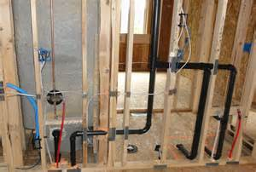
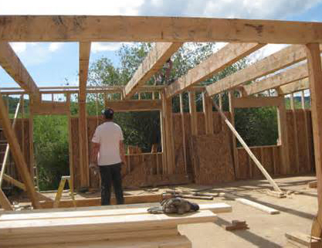
ROUGHING-IN
The rough work in any phase of construction; e.g., framing, mechanical, plumbing, or electrical systems
ROUGH OPENING
An opening in the framework of a building, into which a door or window frame is fitted

Slide 24
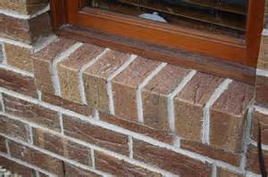
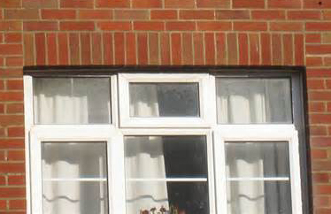
ROWLOCK
A brick laid on its edge so that it is visible, typically used for exterior window sills or as an architectural detail in the brick façade
SOLDIER
A course of bricks laid on end, typically used over and exterior window or door or as an architectural detail in the brick façade

Slide 25
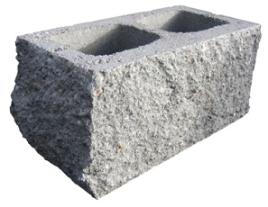
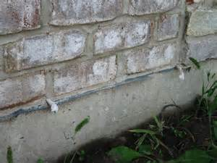
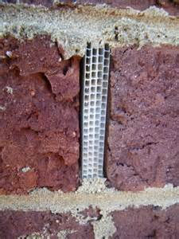
SPLIT FACE BLOCK
A solid or hollow concrete masonry unit, split lengthwise, so as to provide a rough texture
WEEP HOLE
A small opening in a wall or window member, through which accumulated condensation or water may drain to the building exterior

Slide 26
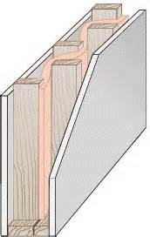
STAGGARD
Descriptive of fasteners, joints, studs, etc., arranged in two or more rows so that the beginning of each row is offset from the adjacent one

