Slide 1
Architectural CAD I – IM230
Vocabulary

Slide 2
GROUP 1
Vocabulary

Slide 3
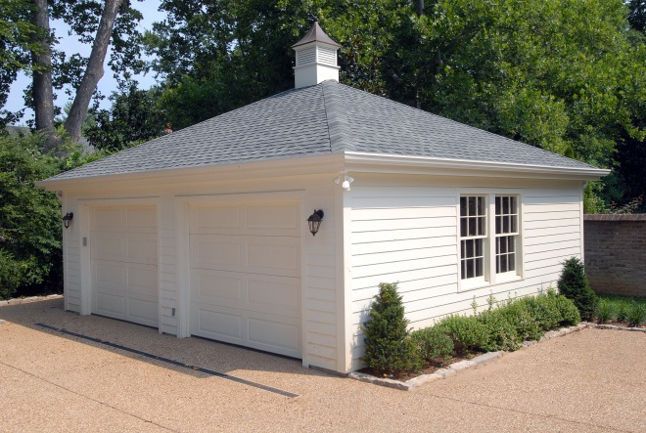
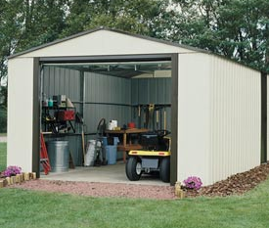
Accessory Building
A secondary building, whose use is incidental to that of the main building located on the same plot.
Garage
Shed

Slide 4
Acre
Area
A unit of land measurement equal to 43,560 square feet.
Measurement of surface within specified boundaries.
OCCUPANT LOAD
The total number of persons that may occupy a building.

Slide 5
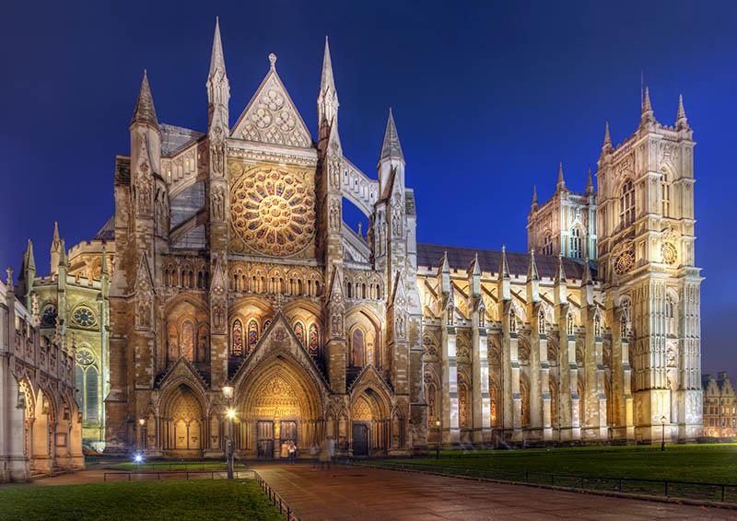
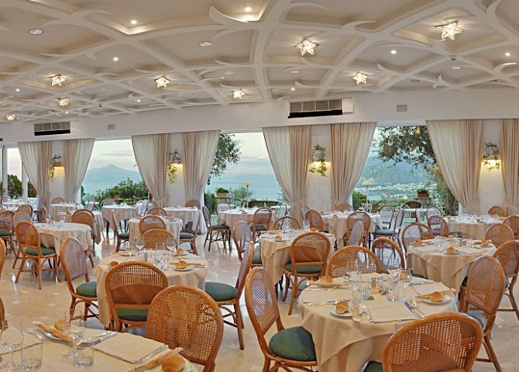
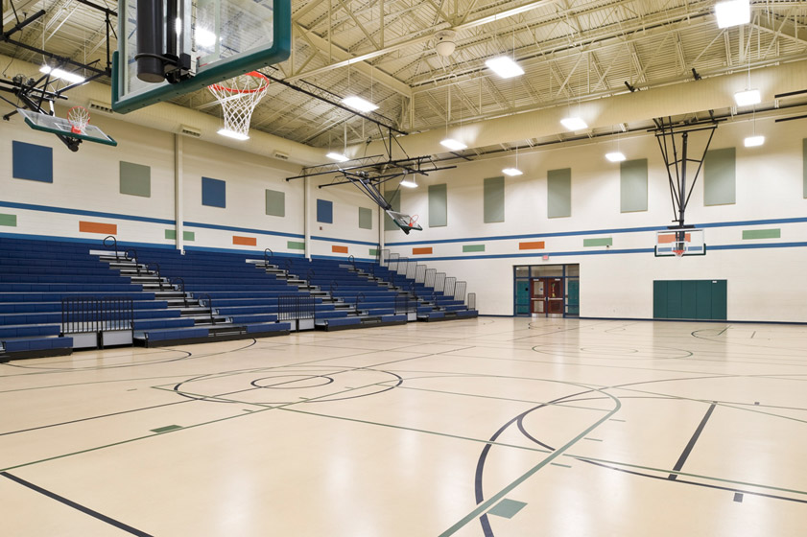
ASSEMBLEY OCCUPANCY
Occupancy of a room, hall, or building by people gathered for a purpose, such as a church, restaurant, auditorium, or athletic venue.
Church
Restaurant
Gymnasium

Slide 6
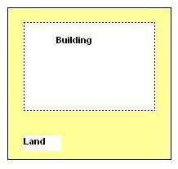
BUILDING AREA/COVERAGE
The total area of a site that is covered by buildings as measured on a horizontal plane at ground level.

Slide 7
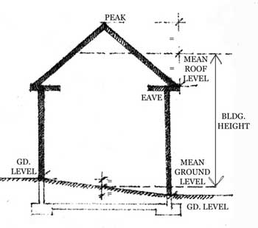
BUILDING HEIGHT
The vertical distance measured from the grade level to the highest level of a flat roof, or the averaged height of a sloped roof.

Slide 8
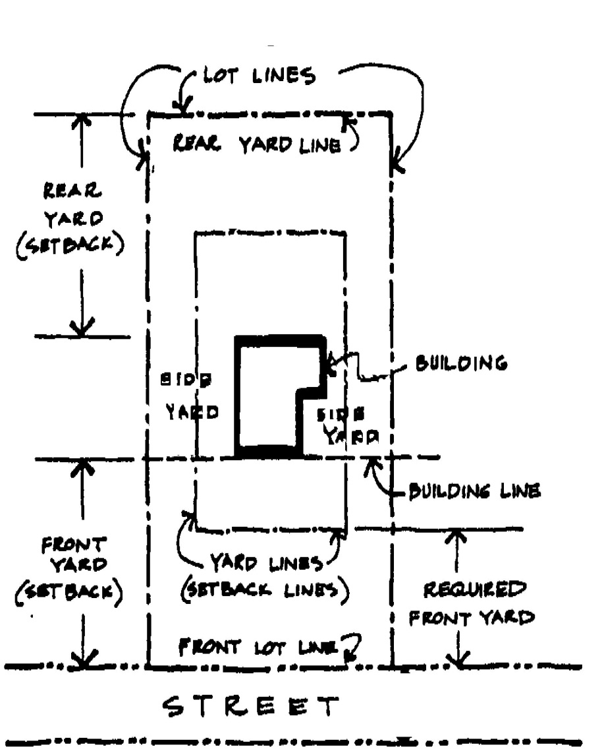
BUILDING LINE
A line established by law or agreement usually parallel to a property line, beyond which a structure may not extend.
LOT/PROPERTY LINE
The legal/recorded defined boundary or limit of a parcel of land.

Slide 9
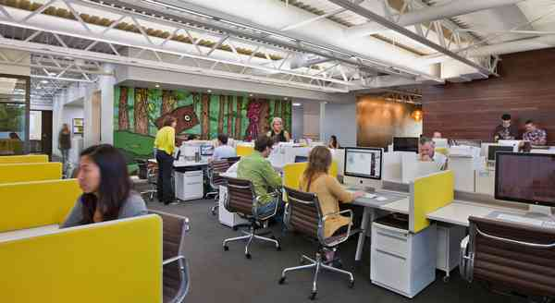
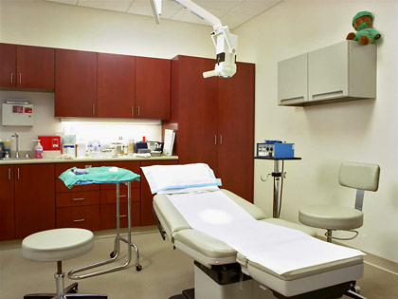
BUSINESS OCCUPANCY
Occupancy of a room or building by people gathered for business, such as a professional office, medical office, or car showroom.
Professional Office
Medical Office
Showroom

Slide 10
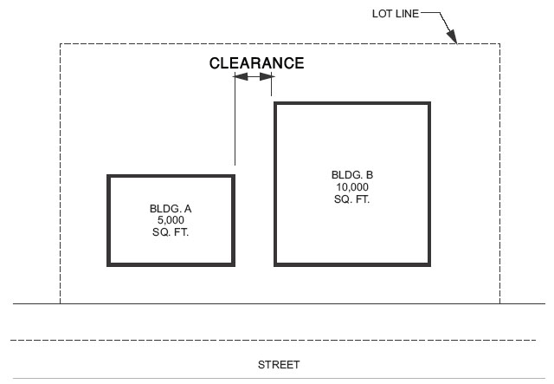
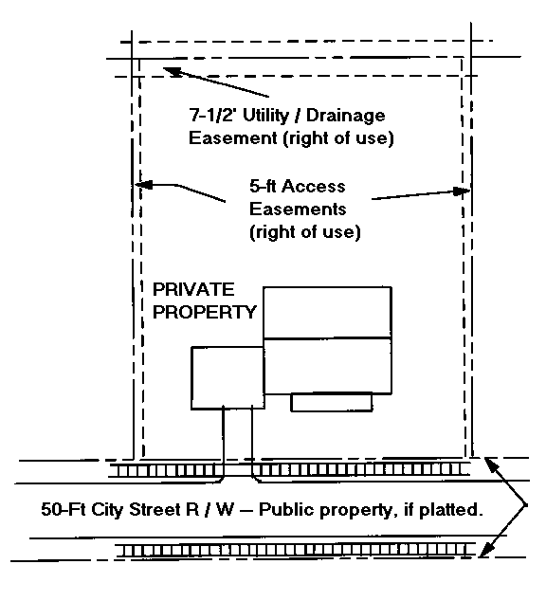
CLEARANCE
Open space between two or more elements of a building to allow unobstructed movement.
EASEMENT
A right of accommodation in land owned by another, such as a right-of-way or free access to light and air.

Slide 11
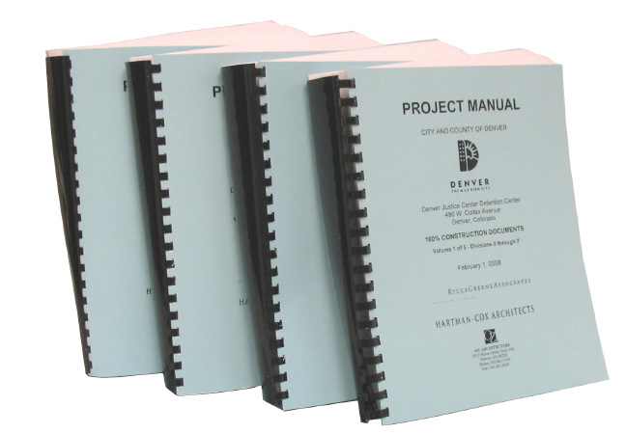
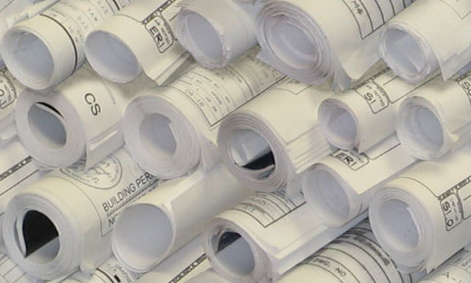
SPECIFICATIONS
A written document describing in detail the scope of work, materials to be used, method of installation, and quality of workmanship.
CONSTRUCTION DOCUMENTS
This consists of the working drawings and specifications for a project.

Slide 12
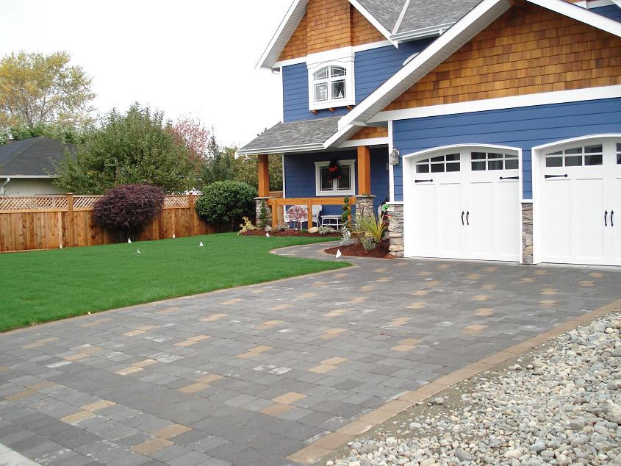
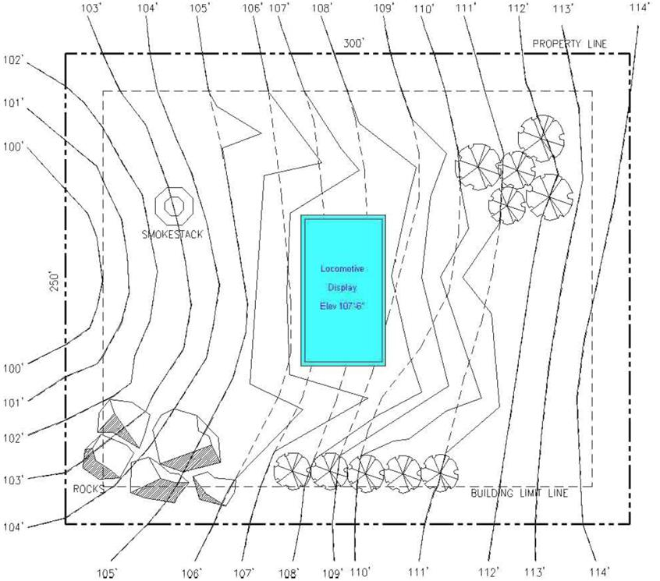
FINISH GRADE
The top surface of lawns, walks, and drives after completion of construction or grading operations.
GRADE
The ground elevation or level at the outside walls of a building or elsewhere on the building site.

Slide 13
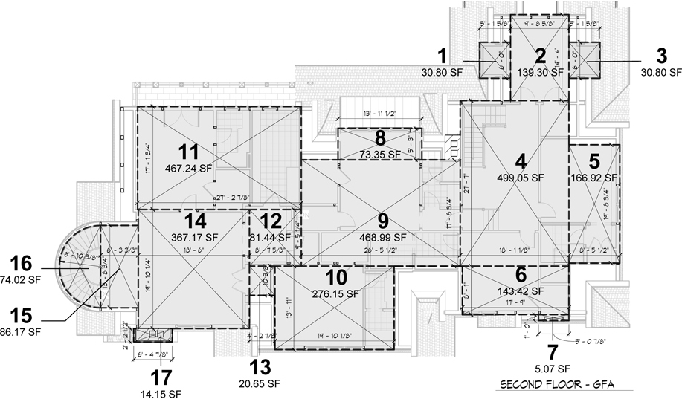
GROSS FLOOR AREA
The area within the perimeter of the outside walls of a building as measured from the inside surface of the exterior walls, with no deduction for hallways, stairs, closets, thickness of walls, columns, or other interior features; used in determining the required number of exits or in determining occupancy classification.

Slide 14
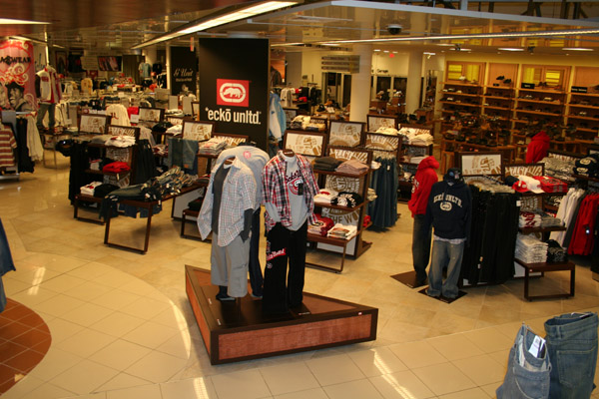
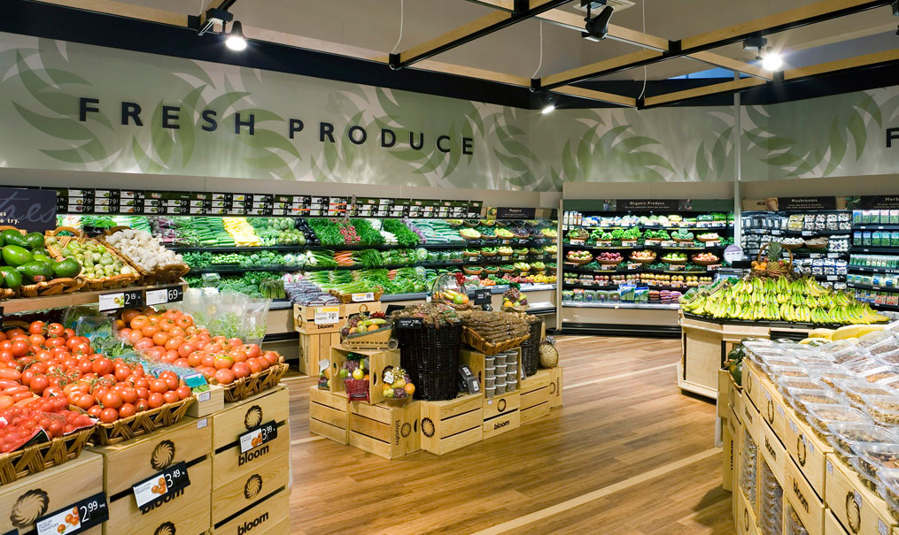
MERCANTILE OCCUPANCY
The use of rooms, stores, markets, buildings, or structures for the display and sale of merchandise.
Clothing Store
Grocery Store

Slide 15
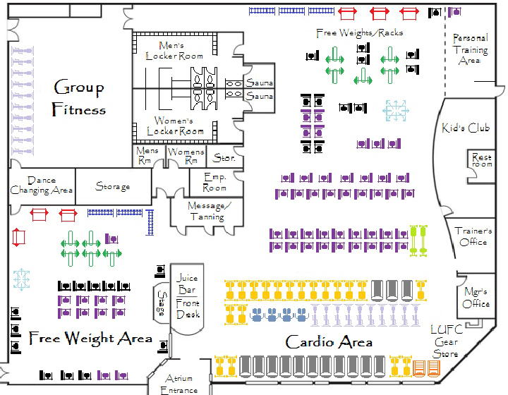
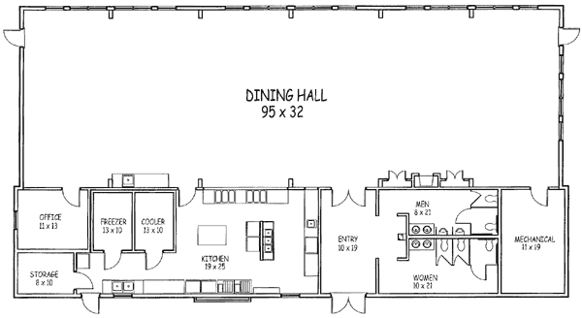
MIXED OCCUPANCY
In a building, two or more classes of occupancy so intermingled that separate safeguards for each class are impractical; the building construction, fire protection, exit facilities, and other safeguards meet the requirements for the most hazardous occupancy unless otherwise specified.
Fitness Center
Banquet Hall

Slide 16
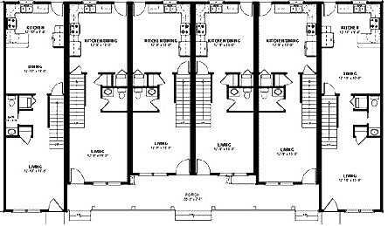
MULTIPLE FAMILY
A building in which more than two families or households live independently of each other and do cooking within their own living quarters.
Townhouses

Slide 17
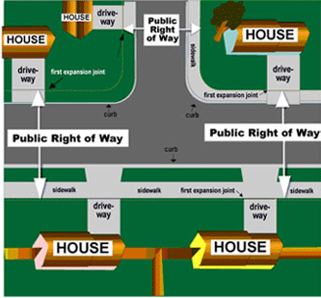
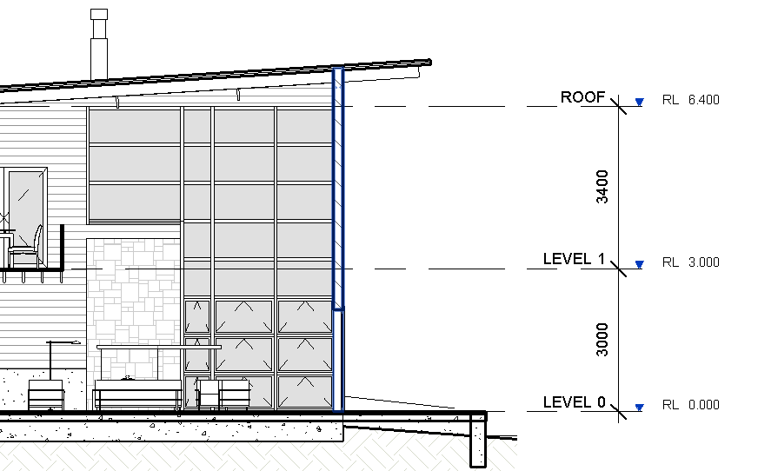
PUBLIC WAY
Any parcel of land unobstructed from the ground to the sky, appropriated for the free passage of the general public.
STORY
The space in a building between floor levels, or between a floor and roof above.

Slide 18
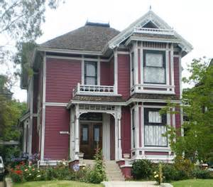
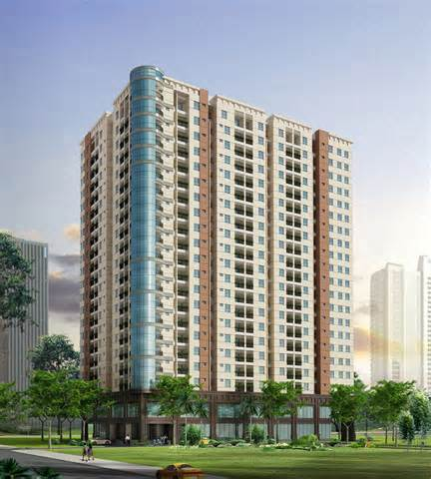
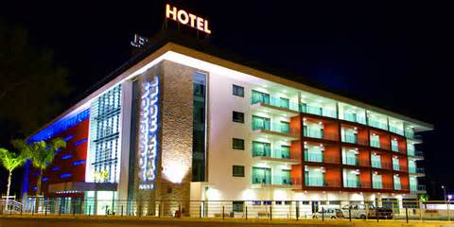
RESIDENTIAL OCCUPANCY
Occupancy of a building in which sleeping accommodations are provided; single and multi-family homes, apartments building, hotels and motels, dormitories, fraternities and sororities, etc.
House
Apartment Building
Hotel

